Slide 1

DER Technical Forum
Microsoft Teams meeting
Join on your computer or mobile app
Click here to join the meeting
Or call in (audio only)
+44 20 3855 5885,,113324700# United Kingdom, London
Phone Conference ID: 113 324 700#
07 June 2021
14:00 start

Slide 2
Welcome, Housekeeping and Introductions

Slide 3
Agenda
14:00 | Welcome, Introductions and Acceptance of Agenda.
14:05 | Special Interest Session on Modelling/Simulations
14:15 | New Issues Definition of Registered Capacity P28 and Dynamic Containment Service
14:35 | Existing issues
14:45 | Storage and Minor Technical Issues – update
14:50 | G100 – Progress
15:00 | DNOs’ ANM published information - update
15:05 | BEIS Asset Registration initiative
15:15 | DNOs’ thinking on Fast Track in response to Powervault
15:30 | Distributed Restart
15:30 | EU Developments
15:35 | AOB
15:40 | Next Meeting Arrangements

Slide 4
Special Interest Session on Modelling and Simulations

Slide 5
Modelling and Simulations
4 definite expressions of interest
Suggest agenda for a meeting covers points the 4 wish to raise
Do we need to consider the implications of GC0141?

Slide 6
New Issues

Slide 7
New Issue 1 - Registered Capacity and Reactive Capability
Q - A common issue that keeps coming up is Registered Capacity vs design install and grid agreements.
I have a specific case where the G99 and connection agreement is for 9MW, the developer undersized the inverters slightly. So it can only produce 8.5MW ( in round numbers) whilst operating in the 0.95 lag/lead range. This is what is shown when we do the G99 study, and we noted this shortfall.
So the question arises, of what happens to the site now and what can it do. Specifically,
Is it’s new official RC 9MW or 8.5MW I.e do they retain their original agreed capacity, or is this list back to the DNO? This is a common sticking point, taking the above example it cannot meet the 9MW required, but they may upgrade an inverter later to give them more MVAr headroom and it could then operate at 9MW.
If the DNO doesn’t want/need them to operate across the 0.95 lag/lead range can they then operate at 9MW active power and say unity or 0.98pf. In this case they are producing their official R, but their system design does not meet the required G99 standard for a 9MW site
A – This is an issue that does re-appear from time to time. We have attempted to deal with it in the past in issues 40, 80 and 83.
Given the issue does re-occur we can introduce some more guidance, or worked examples, either in the DG Connexion Guides or possibly in G99. See next slides.

Slide 8
Registered Capacity
Was revised in G99/1-6 March 2020
Registered Capacity (P_{max})
The normal maximum Active Power capacity of a either a Power Generating Module (in the case of a Power Park Module, the lesser of the Inverter(s) rating or the rating of the energy source), or of a Power Generating Facility, as declared by the Generator taking into account the Active Power consumed when producing the same and the production of the required Reactive Power at the Connection Point.

Slide 9

Losses due to Impedance between Inverters and Connection Point need to be accounted for (1/2)
“40 MW” of PV connected at 132 kV – 40 MW in PGF
40.00 MW
13.67 MVar
42.27 MVA
Assume 1% loss in MW and 5% loss in MVar in cables and across transformer
Connection Point
0.95 pf
Required reactive power 13.02 MVAr
39.6 MW
41.7 MVA
132 kV CP
Power Generating Module (PGM) / Power Park Module (PPM)
Registered Capacity is 40 MW
Power Generating Facility (PGF)

Slide 10
Losses due to Impedance between Inverters and Connection Point need to be accounted for (2/2)
“40 MW” of PV connected at 132 kV – 40 MW exported
40.4 MW
13.8 MVar
42.70 MVA
Assume 2% loss in MW and 5% loss in MVar in cables and across transformer
Connection Point
0.95 pf
Required reactive power 13.15 MVAr
40.00 MW
42.10 MVA
132 kV CP
Power Generating Module (PGM) / Power Park Module (PPM)
Registered Capacity is 40.4 MW
Power Generating Facility (PGF)

Slide 11
Registered Capacity – proposed note for guides
Registered Capacity is the Active Power (kW) of the Power Generating Module (or Facility). A technical capability of 0.95 power factor is generally required at the Connection Point.
There will be a real and reactive power loss between the Power Generating Module and the Connection Point so the kW exported will be less than Registered Capacity (although the active power loss is small and often ignored in practice).
The Standard Application Form asks for maximum active and reactive export power as well as the Registered Capacity and notes that the Registered Capacity can apply to:
a Power Generating Facility. This is the total maximum Active Power capacity of the Power Generating Module(s) in the Power Generating Facility, minus the power consumed by the generation process. For a Power Generating Facility with no other site demand you should take account of the requirement to produce Reactive Power at the Connection Point which will mean considering other equipment such as transformers and cables connecting the Generating Units to the Connection Point. For a Power Generating Facility embedded in a private network with demand it is recommended that you discuss the requirement for the production of Reactive Power with the DNO. Hence the Registered Capacity (kW) will generally be less the than Apparent Power (kVA).
a Power Generating Module. This is the maximum Active Power capacity of the Generating Unit(s) comprising the Power Generating Module, minus the power consumed by the generation process. It needs to take account of the requirement to produce Reactive Power, and whether this is at the Connection Point or at the Module terminals. Hence the Registered Capacity (kW) will generally be less than the Apparent Power (kVA). Where a Power Generating Module comprises inverters, the maximum Active Power capacity of the Generating Unit(s) is the lesser of the Inverter(s) rating or the rating of the energy source.

Slide 12
New Issue 2 – Interpretation of P28 for Dynamic Containment
Q - P28 has the usual classifications of frequent events, infrequent events (4 per month) and very infrequent events (1 per 3 month)…. what should we be assessing a storage system performing a dynamic containment service as?
The UK grid is reasonably stable, at the moment, but with more conventional plant dropping out, the power swings are going to get a bit more severe, and the DC type services will be getting worked more often. Classing it as a very infrequent event probably isn’t realistic, but what about infrequent events? I could see that it is possible that you could get to around the 4 events per month, although probably not at the full power swing.
A - This is a good point, and one that probably would benefit from a consistent consideration by DNOs.
It might be sensible to base the frequency on the observed incidence of frequency excursions, over the last 18 months say, that trigger a specific level of response from such services. The response level might be set locally, and the P28 “frequency of event” set by the historic track of frequency excursions triggering that level of response. This can be calculated from the information NGESO publish monthly

Slide 13
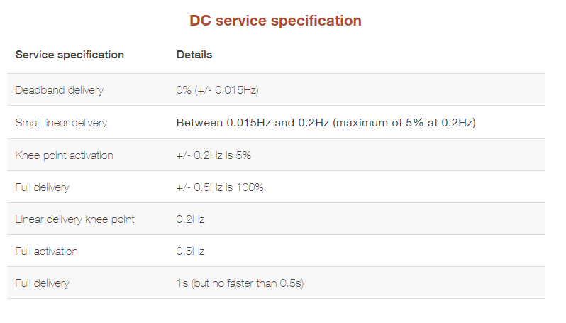
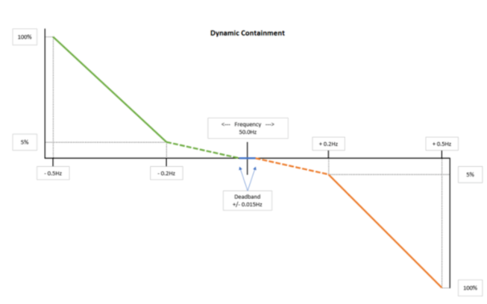
DC Services

Slide 14
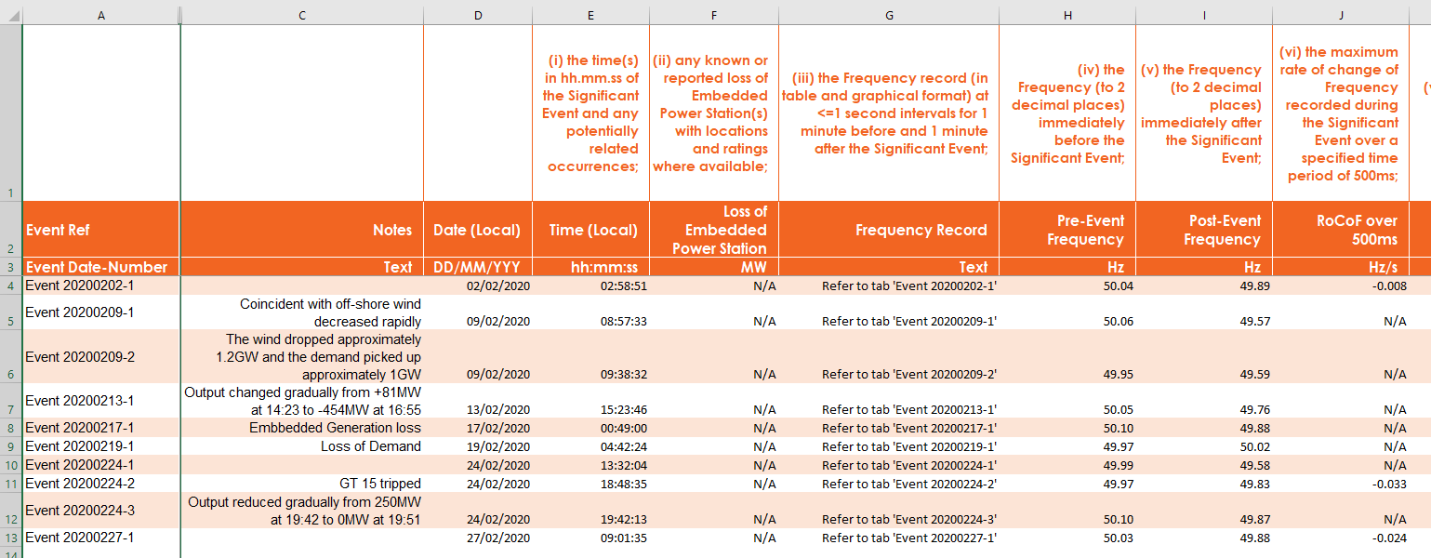
NGESO monthly frequency excursion reports

Slide 15
Incidence of events
In February 2021, events 2, 4, 5, 6, 7 all were excursions giving rise to the conditions for dynamic containment – the power swing can be separately calculated in each case.
At the time of application, the previous 18 months frequency excursions might be used as a reasonable expectation of future excursion incidence.
Or is there a better way to assess the power swing incidence and effect?

Slide 16
Previous Issues

Slide 17
Unresolved Previous Issue
No | Issue | Assumed Status
101 | The issue is the LFSM-O load rejection test, and the scenario given in Appendix C7.5. For a project I have setup a test network for a Type C solar PV site, rated at 15MW and connected at 33kV which has generated some queries. Specifically: It is not clear what the ultimate aim of the test is? ie is it just to show the speed at which the inverters can de-load in the case of an over-frequency condition (ie like the equivalent Type B LFSM-O simple ramp test), or is it to show the system can actually form an island - which doesn’t make sense as the inverters do not have grid forming capability. The value ‘X’ seems to be arbitrary, and the standard wording implies that we just adjust this value until we get the required 52Hz deviation and add the generator rating to this value? Is this above assumption correct or is the value X supposed to be the Design Minimum Operating Level (DMOL)? Whilst practically a solar PV plants minimum, operating level can be very low at say 5% or less, but the inverters would not be able to handle a load rejection of 95%, and most DNO connection agreements, don’t give specific values in the way Grid connection offers do. What is the guidance for selecting the rating of the dummy generator ‘G2’, I have found that setting the value to the same rating as the site, seems to provide the correct response.. but not sure if this is correct? I have also found that it is necessary to add a simple AVR model to the dummy ‘G2’ generator to help stabilise the voltage on the islanded system… I assume this is ok, as the standard only talks about excluding the governor? What is considered a ‘pass’ for this study ie what things are you looking to see? | Following discussions with stakeholders and NGESO it is proposed that the load rejection simulation is only retained for those PGMs where DNO island mode is required. Currently this requirement is very rare, although it might become more prevalent in the future where DNOs wish to use embedded generation to supply customers during network faults etc, or where embedded generation might be providing a black start service to NGESO. In these cases the simulation is entirely appropriate for the duty the generation will be expected to perform. For other installations, it will be more appropriate to use the frequency ramps appropriate for Type B for Type C LFSM-O simulations. It is proposed to modify G99 along these lines at the next opportunity.

Slide 18
Unresolved previous issues - 2
No | Issue | Assumed Status
110 | There is uncertainty over the detail which needs to be submitted for type C and D compliance simulations – particularly the supporting information about the models which could be considered to be the consultants’ IPR. | Although simulations and their models have been discussed several times, and there are a few entries in this log, it might be worth holding a review of what is considered to be appropriate good practice in this area with appropriate stakeholder and DNO experts. Stakeholders will be canvassed to gauge interest in a dedicated session to develop this.

Slide 19
Update on storage, minor technical modifications and G100

Slide 20
Modifications – Storage, Minor Technical Issues and G100
Storage:
  The modification was submitted to Ofgem on 26 April.
  Ofgem website suggests publication of the Authority’s Decision will be 11 June
Minor Technical Issues
  Once the decision on storage is received, we can update G98 and G99 with it, add in the minor technical issues and submit to Ofgem.
G100
  It is expected that following discussion at the DCRP on 03 June, the consultation will be issued around 11 June with a response deadline four weeks later.

Slide 21
Timeline

Slide 22
DNOs’ ANM Information

Slide 23
ANM Updated DNO information
Network Company | Information | Updated
Electricity North West | Electricity North West is not yet using ANM on its network – although it is developing approaches using its network management system. The approach/policy is expected to be published shortly | 10/05/2021
Northern Powergrid | Northern Powergrid has developed four ANM zones with 433MW of contracted generation. We have developed an approach that can be rolled out to further areas and we have accepted customer connections for six further suitable areas, four of which are progressing through the engineering phase. The guidance document prepared for ANM is currently an internal document. If there are any potential ANM customers who would like to get involved, Northern Powergrid is more than willing to share the learnings and provide guidance for ANM connections process and ANM specifications. Northern Powergrid ANM Webinar Title: Active Network Management Getting connected in the East Riding Date: 13th February 2019 Webinar Link: https://www.youtube.com/watch?v=nwpmIFSvXMg&feature=youtu.be Title: Active Network Management Sharing Our Plans Date: 7th Feb 2018 Webinar Link: https://www.youtube.com/watch?v=b5ldDaCSy2E Related Northern Powergrid Code of Practice IMP/001/007 – Code of Practice for the Economic Development of Distribution Systems with Distributed Generation | 11/05/2021
Scottish and Sothern Electricity Networks | SSEN currently has four ANM schemes in BAU operation across its licence areas and is rolling out this approach to 11 new areas in 2021, with over 60% of the SEPD licence area expected to be ANM ‘enabled’ and managing both T and D constraints when completed. SSEN is also developing ANM control for demand and storage connections for release in 2021/early 2022, alongside system and equipment improvements to reduce cost and increase accessibility expected across 2021. SSEN’s information on flexible connexion options for generation, supporting webinars and detail are available here: https://www.ssen.co.uk/FlexibleConnections/ | 13/05/2021
Scottish Power Energy Networks | SPEN’s policy on Flexible Network connections, including ANM schemes is set out in our Flexible Connections and Principles Of Access Policy, document reference ESDD-001-009 which is available on the SPEN website via a link on this page:https://www.spenergynetworks.co.uk/pages/distributed_generation.aspx There is also more information on the Dumfries and Galloway Integrated Network Management innovation project here: https://www.spenergynetworks.co.uk/pages/dumfries_and_galloway_integrated_network_management.aspx | 10/05/2021
UK Power Networks | UK Power Networks provides information on Flexible Connections on its website at: https://www.ukpowernetworks.co.uk/electricity/distribution-energy-resources/flexible-connections UK Power Networks also provides information on curtailment levels across its network through its DG Mapping Tool: https://dgmap.ukpowernetworks.co.uk/site/?q=user/login UK Power Networks requirements for Flexible connections is published in the standard EDS 08-5060 Flexible Connection Requirements which is published on our G81 library: https://g81.ukpowernetworks.co.uk/library/design-and-planning/smart-grid/eds-08-5060-active-network-management-flexible-connection-requirements | 10/05/2021
Western Power Distribution | WPD publishes information on its website regarding Flexible Connections www.westernpower.co.uk/our-network/active-network-management-anm. WPD also publish 132kV and 33kV Connection Guides and a Standard Technique ST:TP18A that relates to the use of Connection Control Panels. These documents are available (ie via the search function) on the following webpage: http://www.westernpower.co.uk/tech-info. | 22.02.2021

Slide 24
BEIS Asset Registration Initiative

Slide 25
BEIS Asset Management Summary 1
Steps to Asset Registration
Installer should be appropriately registered.
    Registered – Competent Persons Scheme
    Not Registered – Local building Control approval
Determine if you needed to notify/apply to the Distribution Network Operator (DNO) before or after installation.
    Notification – G98–within 28 Days – Clear to Install and connect device.
    Application – G99–45 days (LV), 65 Days (HV) – DNO must grant authorisation before connection of device.
Install energy device. (Some energy efficiency schemes require application before installation of energy device.)
Ensure installation is notified with the appropriate bodies.
    The energy device owner is responsible for ensuring the asset has been registered with the relevant DNO,
Customer should receive relevant documentation.
    Certificates from Installer, registered bodies
Apply for relevant energy efficiency schemes.
    Schemes differ dependent on which type of device has been installed

Slide 26
BEIS Asset Management Summary 2
Devices that Require Registration
solar photovoltaic (PV)
electric vehicle (EV) charge point
heat pump
battery storage
Building Regulations to Comply with,
England
Scotland
Wales

Slide 27
Detailed Table of Registration
 | Solar PV / Battery Storage | Heat Pump | EV Charge Point
Installer should be appropriately registered. | Registered – Competent Persons Scheme Not Registered – Local Building Authority | Registered – Competent Persons Scheme, MCS TrustMark Not Registered - Local Building Authority | Registered – Competent Persons Scheme Not Registered - Local Building Authority
Determine if you needed to notify/apply to the Distribution Network Operator (DNO) before or after installation. | Notification (G98) G98 application form Application (G99) G99 application form Battery ‘Application’ (Fast Track) G99 Form A1-2 application form | Notification Proceed to install the device and submit EV/HP application form to the DNO within 28 days of installation. Application Submit the ENA EV/HP application form to the DNO before installing. | Notification Proceed to install the device and submit EV/HP application form to the DNO within 28 days of installation. Application Submit the ENA EV/HP application form to the DNO before installing.
Install energy device. (Some energy efficiency schemes require application before installation of energy device.) | G98 – Install device and notify within 28 Days. G99 – Receive granted Application from DNO (45 days if LV, 65 days if HV) | G98 – Install device and notify within 28 Days. G99 – Receive granted Application from DNO (45 days if LV, 65 days if HV) | G98 – Install device and notify within 28 Days. G99 – Receive granted Application from DNO (45 days if LV, 65 days if HV)
Ensure installation is notified with the appropriate bodies. | device owners must ensure that your installation contractor has notified the relevant DNO. | MCS certified The installation contractor must register the energy device within 10 days. Trust Mark contractor must register the installation in the Trust Mark Data Warehouse | device owners must ensure that your installation contractor has notified the relevant DNO.
Customer should receive relevant documentation. | Building Regulations Completion Certificate from the installation contractor (building notice submitted by installer within 30 days of completion if not registered) Installer affiliated certification if registered Certificate of Installation | Building Regulations Completion Certificate from the installation contractor (building notice submitted by installer within 30 days of completion if not registered) Installer affiliated certification if registered MCS Certificate and Heat Pump Handover Pack or Trust Mark certificate of lodgement or any certification scheme, (the required documentation for that scheme) | Building Regulations Completion Certificate from the installation contractor (building notice submitted by installer within 30 days of completion if not registered) Installer affiliated certification if registered Certificate of Installation
Apply for relevant energy efficiency schemes | Visit Ofgem’s website Smart Export Guarantee Application | Green Homes Grant: apply before installation. You must have applied by 31 March 2021 Domestic Renewable Heat Incentive: apply after installation Non-domestic Renewable Heat Incentive: apply after installation | Electric Vehicle Homecharge Scheme (EVHS) Workplace Charging Scheme (WCS)

Slide 28
DNOs’ early thinking on Fast Track

Slide 29
Fast Track
Existing Fast Track was implemented in Dec 2018.
Its applicability is:
  Existing G83/G98 generation (ie max 3.68kW).
  Addition of storage or generation and storage, also G98 compliant.
  Mandatory G100 export limitation to 16A.
  So maximum connected equipment is 2 x 3.68kW.
DNOs recognize that this is limiting on customers’ ambitions for storage, EVs etc.
The following slides represent some thoughts on which DNOs would appreciate feedback.

Slide 30
DNOs’ design objectives
DNOs need to ensure the following:
  The service equipment is not overloaded.
  Exported power does not push the volts above statutory for other customers.
  The non-linear nature of new domestic loads/generation does not cause harmonic, or flicker, problems for other customers.
The design challenges:
  Local network parameters (particularly loop impedance and normal voltage range) have a significant impact.
  Customer behaviour in the locality and the profiles of their imports/exports are material considerations, but the data, forecasts and analysis are challenging.
  Vast range of customers’ equipment, all with different characteristics

Slide 31
DNOs’ proposals
DNOs propose a three strand approach:
  Approach 1 – allow individual devices with design capacities >16A to be included, overall aggregate of devices limited to 16A, provided their output is limited in software (or other appropriate method) to 16A. This is fit and then inform.
  Approach 2 - Retain the existing fast track process as is.
  A new risk-based approach where generation devices of up to 32A individually would be allowed, provided:
    The aggregate capacity of generation overall is <60A
    A G100 system is installed and set to 32A (if the aggregate capacity of generation is >32A)
    The DNO has a 10 day period to check that the installed devices meet the criteria and that the loop impedance is < [0.18]Ω
In all three approaches, all the generation devices (including storage) must be fully type tested.
Approach 1 has already been used for some vehicle to grid applications.
Approach 3 should provide the opportunity for many more simple connexions, subject to a 10 day check.
If the loop impedance is too high, then a normal G99 application will be required.

Slide 32
Summary of proposals
Approach 1 Registered Capacity (software) constrained to 16A; max aggregate capacity also 16A
Approach 2 Maximum capacity 32A; G100 set to 16A – subject to 10 day DNO acceptance (existing fast track)
Approach 3 Maximum installed capacity 60A; G100 set to 32A – but subject to DNO 10 day acceptance and confirmation of loop impedance
If 0.18Ω is chosen as the final limiting value, this is equivalent to, for example:
200kVA TX, 300m of 185mm² waveform cable and a 30m service cable.
500kVA TX, 350m of 185mm² waveform cable and a 32m service cable.
500kVA TX, 440m of 240mm² waveform cable and a 40m service cable.
Please let us have any comments on these proposals by 21 June.

Slide 33
Distributed ReStart Project

Slide 34
Distributed Restart Project -1
Introduces the concept of an Anchor Generator, which is an embedded PGM cable of self starting and re-energising the DNO’s system, supplying DNO’s customers, and ideally being able to re-energize an element of the transmission system.
The Project’s working assumption is that such PGMs might be as small as 2MW, but in all cases would be required to accede to the CUSC.
The draft requirements are being incorporated into Grid Code OC9 (black start) and OC5 (testing).
If all formal participants of a distributed restart zone (DRZ) are CUSC parties, there is arguably no overwhelming need to place requirements in the D Code. However, in both the interests of not limiting the approach to CUSC parties, and transparency and clarity, it seems highly desirable to create harmonized requirements in DOC9 and DOC5.

Slide 35
Distributed Restart Project - 2
The Project currently intends to use GC0148 (E&R Implementation – a joint GCRP/DCRP WG) to introduce the Grid and Distribution Code modifications – although this might not happen if the DRZ drafting is too much scope creep for GC0148.
NGESO also have to respond to their new Electricity System Restart licence condition, which might lead to a change of status and ambition for the project.
NGESO has mentioned the touch point too with GC0117 in terms of where an embedded PGM will become Large in future.
G99 largely avoids direct conflict with DRZ requirements, but would benefit from a few tweaks (particularly to the definition of its scope) to remove any possible confusion.
The project is aiming to capture its first thoughts on drafting of the Grid Code, D Code and G99 in June/July 2021.

Slide 36
EU Developments

Slide 37
3 key developments
The Expert Groups are expected to report to the European Stakeholder Committee on 10 June.
Potentially these will feed into updates to the network codes – so not likely to be primary legislation in the UK
  Baseline for Type A generators
    TSOs want fault ride through for all type A
    DNOs (and manufacturers) want greater clarity and harmonization on certification
    DNOs and TSOs want Type B controllability rather than just an off-switch
    All the above might be excepted for μCHP and CHP (and other specific technologies) ≤ 50kW
    Not proving easy to turn all this into a report.
  Criteria for Significant Modernization
    Will recommend that thresholds for key electrical characteristics (eg 50% increase in registered capacity) trigger full compliance.
    Might provide useful clarity; might be ineffectual (depending where the thresholds are set).
  Interaction Studies and Simulation Models
    Additional modelling options for TSOs to impose on Type C and D generators, and for new distribution systems (no such thing) and facilities (GSPs)
    Currently unclear if these will be mandatory on embedded generators, or at DNO discretion
    NGESO not represented and do not seem interested - probably because their interests are being developed in GC0141

Slide 38
Wrap up:

Slide 39
Minutes of previous meeting and actions
Outstanding matters arising not on the agenda:
  None?

Slide 40
AOB and next meeting
AOB
None
Next meeting? W/C 20/09?

Slide 41
© ENA 2020

