Slide 1
DCRP WG Storage
30 September 2020

Slide 2
Agenda
Time | Focus | Leader
14:00 | Welcome, Introductions and Acceptance of Agenda | CM
14:10 | Review of Open Actions from Last Meeting | CM
14:15 | Review Proposed Modifications to Documents V2G Frequency Response Drafting G98 G99 DCode | MK/SC
15:25 | Proposed approach to storage types/data etc | MK
15:30 | DCRP/MP/20/06 Consultation Paper Content and detail Consultation questions | MW/MK
15:50 | AOB Date of Next Meeting | MW

Slide 3
Actions
No. | Detail | Leader | Date | Complete
Action 1 | AMC to provide comments on ToR | AMC | ASAP | ✓
Action 2 | Clarify likely future treatment of storage as load and also flexible load for frequency control purposes (see slide 10 in this pack) | MK | Next meeting | ✓
Action 3 | Research if other nascent technologies and manufacturers need to be considered | MH | Next meeting
Action 4 | Draft sketches relating to inverter positioning for V2G equipment | SC | Next meeting | ✓
Action 5 | Continue to Reach out to manufactures re:V2G. BMW and JLR | CM | Next meeting
Action 6 | Draft Marked up copies of G98, G99 and DCode. | SC/MK/MW | Next meeting | ✓
Action 7 | Take draft modification consultation and legal text to October DCRP | CM | Oct DCRP
Action 8 | Suggest consultation questions | ALL | 14/08/20
Action 9 | Draft consultation paper | CM/MK/SC | Next meeting | ✓
Action 10 | Write to National Grid | MW
Action 11 | Circulate Draft Minutes | CM | 12/08/20 | ✓
Action 12 | Circulate Doodle poll and schedule next meeting from results. Date Range – 31st Aug > 8th Sept. | CM | 12/08/20 | ✓

Slide 4
Electric Vehicles – résumé from 02/07/20 meeting
The EU ESC Expert Group discussed this at length and noted the helpful ACER terminology of V1G for EVs that do not export back to the system, and V2G for vehicle to grid capabilities
V1G must be treated just as demand – including flexible demand to the extent that any party is controlling the load cycle – so not included in G99 or G99
V2G should be treated at least the same as V1G for considering its recharging cycles, but must be treated as generation during any energy discharge cycle that exports electricity
Compliance with connexion requirements will be at the connexion point; the onus on dealing with multiple vehicles and their aggregation in to a compliant power generating module as seen from the connexion point will be the responsibility of the owner of the site, be it a domestic installation or a large long term car park (eg an airport). Clearly very large car parks could present as a power generating module larger than Type A.

Slide 5
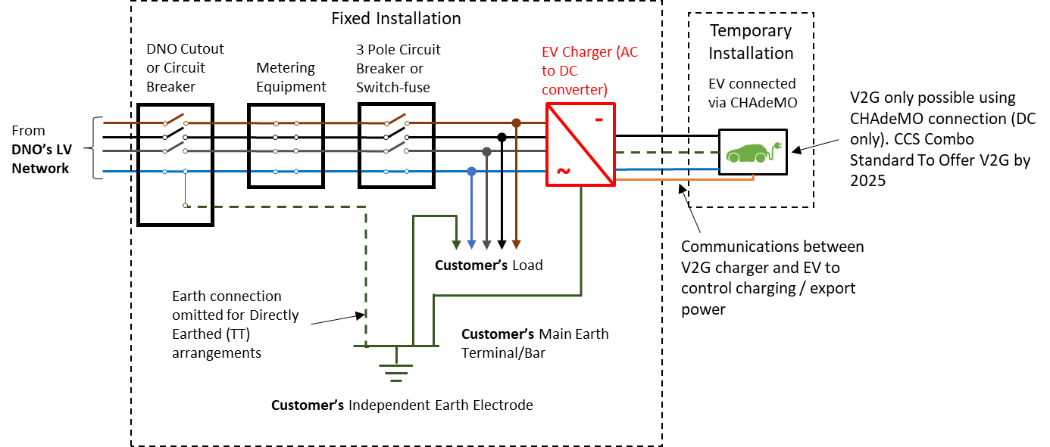
Vehicle to Grid – arrangements DC
The EV charger is the Power Generating Module – or is a Power Generating Unit if there is more than one EV charger within the installation.

Slide 6
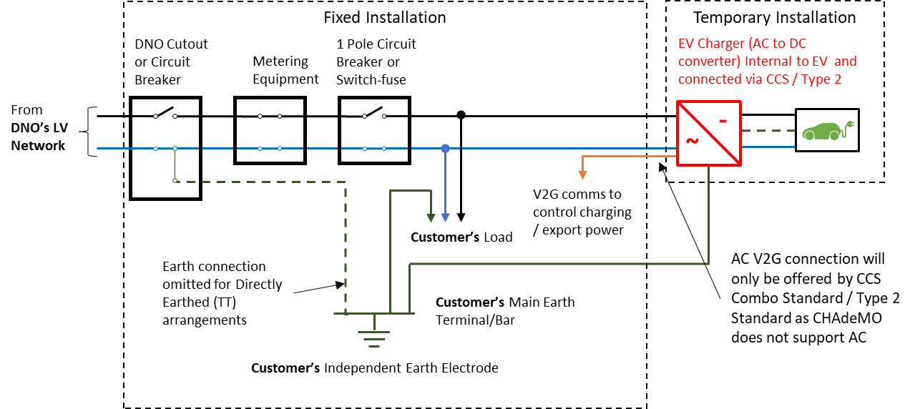
Vehicle to Grid – arrangements AC
The EV charger is the Power Generating Module – or is a Power Generating Unit if there is more than one EV connected to the installation.

Slide 7
V2G Connexion Process etc

Slide 8
EV Compliance
The existing régime for compliance will need to accommodate EV chargers both as stand alone devices, as well as built into vehicles.
In both cases the manufacturers will have to provide type test certification
EVs are already a highly regulated area; general road traffic regulations and smart charging requirements. Is there a need to liaise with other regulatory bodies in implementing V2G requirements?
Should manufacturers’ certification be raised to the formal status of Equipment Certificate? The onus is on site owners to ensure that visiting AC connected V2G EVs are compliant – this would suggest that there needs to be a robust régime for ensuring all V2G EVs are compliant from the factory.

Slide 9
Frequency Response
Timing – there is no current requirement to do more than implement the RfG requirements
However, international and national developments are moving in the direction of storage providing more emergency support than the RfG requires
GC0148 will be developing the GB requirements
We know NGESO’s current thinking, in advance of GC0148 developments – it is captured in an alternative to GCC0127 that was not progressed at that time, and in the GB submission to the European Stakeholder Committee Expert Group on Storage, whose report will form the basis of revisions to the RfG and DCC

Slide 10
Frequency Response - 2
GC0127 and ESC EG Storage frequency response proposal
The required characteristics applied to storage that is importing are:
On falling frequency reaching 49.5Hz the automatic response should start.
The frequency response characteristic is to be within the shaded area
If the Power Generating Module is not capable of moving from an import level to the appropriate export level within 20s it should cease all import if the frequency falls below 49.2Hz
If the Power Generating Module has not achieved at least zero Active Power import when the frequency has reached 48.9Hz it must be tripped immediately.
Exporting (discharging)
Importing (charging)

Slide 11
Frequency Response - 3
There was an action from the 05 August to report on EU discussions on extending frequency response to Demand Units, ie customers devices where power is modulated for DNO or TSO purposes
It was recognized as being potentially valuable – but not currently being taken forward as
There is no mandate to make such changes to the Demand Connexion Code
It probably makes more sense to gain experience with Storage first
Would it be same set of characteristics as Storage? Not certain.
0
DEMAND

Slide 12
Drafting
G98 includes the issues discussed in detail at 05/08/20 meeting
G99 similarly includes the detail from the same meeting
Both documents include the suggested provisions discussed above for EVs and frequency response
All changes are marked up in change tracking mode
The D Code mod is a simple deletion of a sentence – marked up in the draft consultation paper
The frequency response requirements still need reviewing in terms of compliance demonstration requirements

Slide 13
Data for storage installations
G98 contains the application form which must be used for G98 connexions, and which includes storage technology types – but this is out of date
The standard application form for G99 is currently more up to date than the G98 version
The DDRC in the Distribution Code is also not up to date
The recently introduced Embedded Capacity Registers have introduced some further data reporting requirements
There is a DCRP Working Group looking explicitly at data and data transfer requirements
There is little point in two WGs trying to resolve the same issue separately
It is proposed to ignore data requirements in our storage modifications, recognizing that the data/data transfer WG will update all these requirements as part of its work

Slide 14
Consultation paper
Tries to explain the draft modifications as simply as possible
Draft consultation questions
Do you agree with the general intent of the proposed modification? If not, please explain your views.
Do you agree with the approach to a timed future implementation and do you agree with the suggested date?
Do you agree that the data requirements relating to storage technologies etc should be left to the DCRP working group on data exchange provisions to resolve?
Do you agree with the general approach taken to V2G requirements? If not, please state what you think is incorrect and inappropriate and please suggest any alternative approaches.
Do you agree that DNOs should insist on formal Equipment Certificates for manufacturers to demonstrate compliance of V2G capabilities? If you disagree, please explain why.
Do you agree with the inclusion of mandatory cessation of active power on falling frequency and do you agree with the thresholds suggested?
Do you have any comments on the proposed legal text drafting?
Do you have any other comments?
Will need to add in standard questions about the modification better achieving the Distribution Code objectives
Comments welcome on all of the above
Also – how do we reach all the key parties that need to review the consultation?

Slide 15
AOB and date of next meeting

