Slide 1

DER Technical Forum
15 December 2020
Microsoft Teams meeting
Click here to join the meeting
Or call in (audio only)
+44 20 3855 5885,,731519845#
Phone Conference ID: 731 519 845#

Slide 2
Welcome, Housekeeping and Introductions

Slide 3
Agenda
Time | Focus | Leader
14:00 | Welcome, Introductions and Acceptance of Agenda. | CM
14:02 | Acceptance of minutes of previous meeting (03 November 2020) | CM
14:05 | Update on Housekeeping etc Modification | CM/MK/SRC/CN
14:50 | New issues raised 106 – challenges for small rotating machines 107 – DRUPS – long term parallel? | MK
15:00 | Remaining Open Issues: 101 – load rejection simulations for Type C and D | MK
15:05 | Update on Storage Modification | CM/MK/SRC
15:35 | G100 – update | AH/MK
15:40 | TTR etc update (if any) | CM/MD
15:45 | AOB
15:50 | Finish and next meeting | CM

Slide 4
Update on housekeeping modifications

Slide 5
Revised Timeline following 03/12/20 DCRP

Slide 6
EREC G98

Slide 7
EREC G98 Housekeeping modes
Amended definition of Registered Capacity to align with G99
Mods to G98 and G99 for small rotating machines – Mike Kay will discuss later in the agenda

Slide 8
Removal of references to EN 50438 (1)
In the initial drafting of EREC G98 from EREC G83, a number of requirements were removed from G98 and replaced with references to EN 50438, in order to align with Standard documentation.
EN 50438 has now been withdrawn; and replaced with EN 50549 Part 1, but this does not fully replicate EN 50438 and does not detail test requirements. Test requirements are expected to be detailed in EN 50439 Part 10 which is currently in draft.
The DNOs and the DER technical forum agreed a preference to remove reference to EN 50438 from G98, and reinstate the requirements that had previously been removed.
This results in lots of modifications in EREC G98 – examples on next slide.

Slide 9
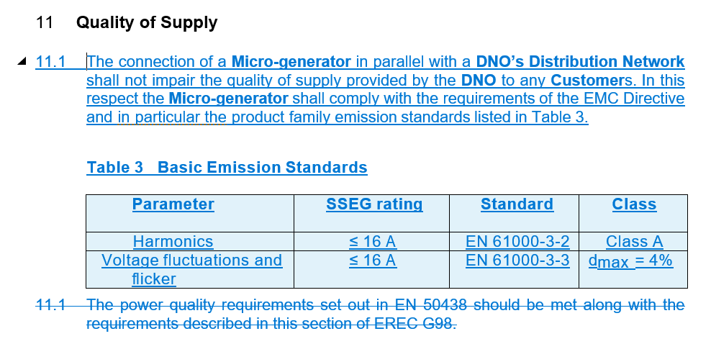
Removal of references to EN 50438 (2) - Example

Slide 10
Removal of references to EN 50438 (3) – Example: operating temperature
EN 50438 clause:
The manufacturer shall declare the ambient operating temperature range of the micro-generator and verify where appropriate that the interface protection control system operates satisfactory throughout this temperature range.
Proposed G98 clause:
The Interface Protection shall function correctly, ie operate within the required tolerance range as given in paragraph 10.1.4, across the expected range of ambient operating temperatures and other environmental factors.

Slide 11
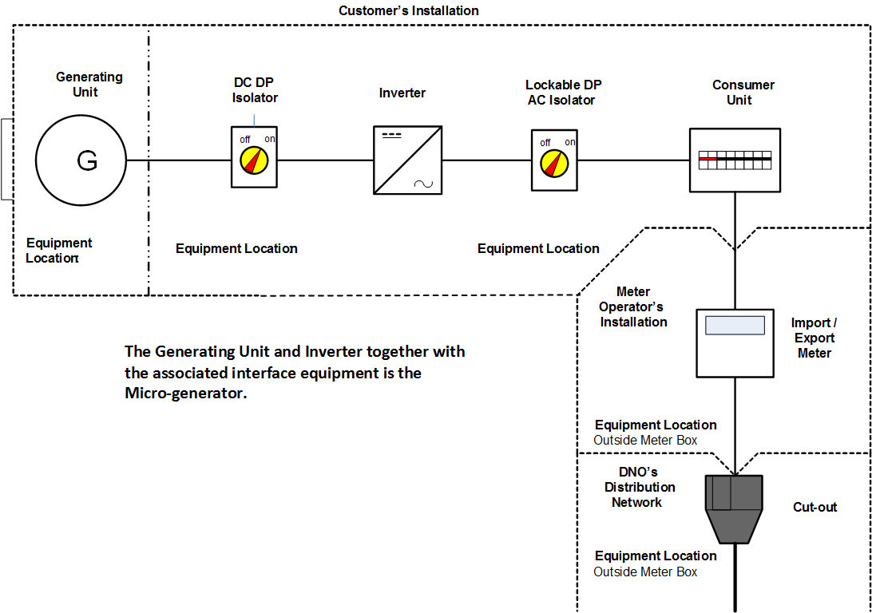
Update Figure 2 Circuit Diagram
7.3.3 contains an example of a circuit diagram that could displayed at the connection point.
The current figure includes a FIT (Feed in Tariff) meter, which is out of date as the FIT has closed to new applicants.
The figure will be updated to remove the FIT meter, and combine the separate import and export meters into a single device.

Slide 12
Modification to G83 installations
NEW 8.4.4 Where a Micro-generator installed under EREC G83 is substantially modified (eg a significant piece of equipment, such as an inverter, is replaced) then it will be necessary for that Micro-generator to be modified to be compliant with this EREC G98. Modifications to an existing Micro-generator which complies with the requirements of EREC G83 that are not considered to be substantial do not change the compliance requirements of that Micro-generator, ie it can remain compliant with EREC G83. EREC G99 Annex A.6 provides guidance on modifications that are considered substantial. While this is aimed at larger generation installations than this EREC G98, some of the guidance may be helpful.
Footnote: EREC G99 Annex A.6 provides guidance on modifications that are considered substantial. While this is aimed at larger generation installations than this EREC G98, some of the guidance may be helpful.

Slide 13
Minimum Stable Operating Level
Two new clauses are proposed for G98, 9.3.3 and 9.3.4, in relation to the Micro-generator not being expected to operate below its minimum stable operating level in the provision of LFSM-O.
NEW 9.3.3 If the reduction in Active Power is such that the Micro-generator reaches its minimum stable operating level, it shall continue to operate stably at this level.
NEW 9.3.4 Steady state operation below minimum stable operating level is not expected but if system operating conditions would cause operation below minimum stable operating level then the Micro-generator shall be able to return to an output of not less than the minimum stable operating level.

Slide 14
Cyber security (1)
A new requirement has been introduced in Section 9 for all equipment within the scope of G98 to comply with:
“ENA and Department for Business, Energy and Industrial Strategy (BEIS) Distributed Energy Resources (DER) – Cyber Security Connection Guidance” and
PAS 1879 “Energy smart appliances – Demand side response operation – Code of practice”.
Both of these documents will be added to the list of references.
A section will be added to Form C Type Test Verification Report for the manufacturer to confirm that the Micro-generator complies with the cyber security requirements.

Slide 15
Cyber security (2)
NEW 9.7.1 Every Micro-generator and any associated equipment must be designed and operated appropriately to comply with cyber security requirements. As a minimum the recommendations in “ENA and Department for Business, Energy and Industrial Strategy (BEIS) Distributed Energy Resources (DER) – Cyber Security Connection Guidance” (or any successor document) and the relevant principles for cybersecurity from PAS 1879 “Energy smart appliances – Demand side response operation – Code of practice” should be implemented.

Slide 16
Compliance forms
Additional tests for operating range (test 1 20 seconds at 47 Hz and test 6 RoCoF withstand).
Additional test (test 5) for continuous operating range.
Additional row for the manufacturer to indicate, for three-phase Micro-generators, whether harmonic measurements for all three phases are identical. Where they are not, the Manufacturer is requested to complete the measurement form for each phase.
Guidance to “delete as appropriate” for standard impedance in voltage fluctuations and flicker test.
Move location of test start date / test end date / test location to the top of the voltage fluctuations and flicker test, to make it clearer that this needs to be completed.
In Power Factor test, remove four rows for results at different levels of Registered Capacity and replace with a single row for measured output.
LFSM-O test: add a note about measurement tolerances with reference to A.1.2.8.
Fault level contribution: add a note to complete all entries, even if the fault contribution is zero.
Logic interface: Add a row requesting a high level description of logic interface, with reference to 9.4.3.

Slide 17
EREC G99

Slide 18
EREC G99 Housekeeping mods (1)
The reference to ETR (Engineering Technical Report) 126 will be updated to EREP (Engineering Report) 126. References to this document in the following paragraphs of G99 will be updated: 11.4.2, 11.4.5, 12.4.2, 12.4.6, 13.4.2 and 13.4.8.
The definition of Connection Agreement will be modified to clarify that site requirements relate to the Power Generating Facility.
Minimum Regulating Level will be moved to precede Minimum Stable Operating Level, to be in correct alphabetical order.
Cyber security – as per G98 mod (slides 14-15). A new clause will be added (9.1.7) and a section will be added to Compliance Verification Reports (A2-1, A2-2 and A2-3) for the manufacturer to confirm that the Power Generating Module complies with the cyber security requirements.
Monitoring of tripping supplies – small modification to 10.3.8.

Slide 19
EREC G99 Housekeeping mods (2)
A review has been conducted of the use of the terms Minimum Regulating Level and Minimum Stable Operating Level in G99. As a result a number of instances of the term Minimum Stable Operating Level will be replaced with Minimum Regulating Level, including in paragraphs: 13.2.3.4(b)(i), A.7.2.4.1, B.5.2.5, B.6.2.6, C.8.6.3, C.8.6.5, C.9.5.4, C.9.5.6 and C.10.2.3.
Due to an omission from previous versions of G99, it is proposed that an additional test in included in the set of reactive capability tests (Annex C.9.3).
Small rotating machines – as per G98 mod, discussed in next agenda item.
Demonstration of reactive capability – amendments to B.4.2.1 for clarity, including reference to Generator Performance Chart in footnote.

Slide 20
EREC G99 Housekeeping mods (3)
Annex B.4.4.3 and C.7.5.3 amended to include reference to a minimum short circuit power for simulation purposes, specifically, for the Fault Ride Through simulations. DNOs agreed that 50 MVA for Power Generating Modules that are Type B and above is a generic minimum fault level that can be used in most cases. For the few specific cases where the fault level might be lower than this there will need to be a specific discussion between the Generator/developer and the DNO.
C.5.6.1 and C.5.7.1 will be amended to clarify that these sections only apply where the Power Generating Module is required to conform with the Grid Code.
C.7.5.5 will be amended to clarify that Manufacturers’ Information relates to information provided to either the DNO to demonstrate compliance with EREC G99, or to NETSO, who will confirm Grid Code compliance with the DNO.
C.7.6.6 clarified that the simulation models should be validated against the actual test results.

Slide 21
Provision of a model (1)
An issue was raised via the DER Technical Forum that there is an inconsistency between clauses 6.3.7 and 6.3.8 regarding the requirement to provide a validated detailed model of the power generating module.
The proposed amended clauses are in alignment with previous G59 requirements and the RfG:
6.3.7 Detailed models of a Type A or Type B Power Generating Module are required where the DNO deems it necessary to ensure System Stability and security. Detailed models are always required for Type C and Type D Power Generating Modules.
…
6.3.8.5 Generators shall submit validated detailed models in respect of Generating Units which are aggregated into a Power Park Module.

Slide 22
Provision of a model (2)
In additions, DNOs have raised concerns that, when provided with black box models of Power Generating Modules (as per 6.8.3.4(b)), they have not been able to confirm whether or not the model suitably represents the performance of the Power Generating Module.
It is proposed that new text is added to 6.8.3.4(b) as follows:
“This includes providing guidance on the model or study cases and scenarios, should the DNO request such information .”

Slide 23
Intentional islanding (1)
It is proposed that the section in G99 on islanding (9.6) is amended to allow for the situation whereby a Generator wishes to deliberately support a customer installation in the event of a loss of connection to the DNO’s distribution network.

Slide 24
Intentional islanding (2)
NEW 9.6.2 Generator’s Installation Island
9.6.2.1 Wherever a Generator’s Power Generating Module runs in parallel with the DNO’s Distribution Network for more than 5 minutes per month, the design of the Power Generating Module and the Customer’s Installation must meet the requirements for long term parallel operation and comply with all the appropriate requirements of this EREC G99.
9.6.2.2 When the Power Generating Module is operated supplying just the Customer’s Installation, it is the Generator’s responsibility to ensure the safety of the Customer’s Installation in respect of electrical and general safety.
9.6.2.3 The arrangements of Figures 8.6 (HV) and 8.9 (LV) will generally be appropriate for earthing and switching arrangements. Exact designs of Generators’ Installations will vary, but the functional requirements of these figures should be implemented.
9.6.2.4 It is the Generator’s responsibility to ensure appropriate and safe synchronisation to, and disconnection from, the DNO’s Distribution Network, respecting the requirements of P28 on voltage disturbances on the DNO’s Distribution Network.

Slide 25
Output power with falling frequency for gas turbines (1)
EREC G99 contains output power with falling frequency requirements in sections 11.2.3, 12.2.3 and 13.2.3 for Type A, Type B and Types C and D respectively.
The equivalent requirement in the Grid Code (ECC6.3.3.1) currently has a relaxation on this requirement for Combined Cycle Gas Turbines (CCGT). This relaxation states that the response to this requirement from CCGT only needs to be provided for five minutes if to continue to provide a response after that period of time would put the gas turbine at increased risk of tripping. This is to recognise the inherent characteristics of gas turbines losing power output at low frequencies ie at lower rotational speed of the turbine. This relaxation for CCGT is not currently captured in EREC G99.
Amendments will be made to the relevant sections of G99 (11.2.3.1(b), 12.2.3, 13.2.3) to make this allowance for CCGTs. The amendments are in line with the Grid Code text.

Slide 26
Output power with falling frequency for gas turbines (2)
Additional text in 11.2.3, 12.2.3, 13.2.3:
In the case of a CCGT Module the above requirement shall be retained down to 48.8 Hz, which reflects the first stage of the Automatic Low Frequency Demand Disconnection scheme. For system frequency below that setting, the existing requirements shall be retained for a minimum period of 5 minutes while system frequency remains below that setting, and special measure(s) that may be required to meet this requirement shall be kept in service during this period. After that 5 minute period, if system frequency remains below the 49.5 Hz threshold, the special measure(s) must be discontinued if there is a materially increased risk of the Gas Turbine tripping. The need for special measure(s) is linked to the inherent Gas Turbine Active Power output reduction caused by reduced shaft speed due to falling system frequency. Where the need for special measures is identified in order to maintain output in line with the level identified in Figure 11.1 these measures should still be continued at ambient temperatures above 25⁰C maintaining as much of the Active Power achievable within the capability of the plant.

Slide 27
Rapid resynchronisation (1)
An RfG requirement A15 5 (c) on rapid resynchronisation was omitted in error from the G99 Type C and D requirements.
A new clause 13.7.2 will be added to G99.
In addition a row will be added to the Type C and Type D PGMD to confirm operation of rapid resynchronisation, where it is required.

Slide 28
Rapid resynchronisation (2)
NEW 13.7.2 In case of disconnection of the Power Generating Module from the Distribution Network, the Power Generating Module shall be capable of quick re-synchronisation if required by the NETSO. If the NETSO requires rapid resynchronisation it will agree the strategy with the DNO and the Generator. Where rapid resynchronisation is required:
(a) A Power Generating Module with a minimum re-synchronisation time greater than 15 minutes after its disconnection from any external power supply must be capable of houseload operation from any operating point on its Power Generating Module Generator Performance Chart. In this case, the identification of houseload operation must not be based solely on the DNO’s switchgear position signals;
(b) Power Generating Modules shall be capable of houseload operation, irrespective of any auxiliary connection to the Distribution Network. The minimum operation time shall be specified by the NETSO, taking into consideration the specific characteristics of prime mover technology.

Slide 29
Family approach to type testing (1)
VDE, a German testing and certification institution, accepts an approach to type testing within “families” of Generating Units. A family is a model produced by a manufacturer that varies in size. Within a limited range (with different ranges for synchronous generating units and Power Park Modules) if the compliance of one Generating Unit in a family has been demonstrated, all units in that family can be considered type tested. It is the responsibility of the manufacturer to justify why the results for one unit are transferrable (eg they have the same control system).
New clauses will be added to G99 15.6 to allow for the same approach.

Slide 30
Family approach to type testing (2)
NEW 15.6.1 A family approach to type testing is acceptable, whereby Generating Units that are the same model and produced by the same Manufacturer but vary in size can be considered to be Type Tested once one Generating Unit in the family has been shown to be compliant. The approach is permissible in the following range of Generating Unit sizes:
For Synchronous Generating Units:
    Lower limit: 1/√10 (0.3162) of tested Generating Unit apparent power
    Upper limit: √10 (3.162) times tested Generating Unit apparent power
For all other Generating Units:
    Lower limit: 1/√10 (0.3162) of tested Generating Unit apparent power
    Upper limit: 2 times tested Generating Unit apparent power

Slide 31
Family approach to type testing (3)
15.6.2 All absolute values (eg operating range tests) shall be transferred directly in the compliance forms. All relative results related to design Active Power or current (eg power quality fluctuation and flicker) shall be transferred according to the ratio of the respective Active Power rating / Registered Capacity of the tested Generating Unit and the assumed compliant Generating Unit.
15.6.3 It is the responsibility of the Manufacturer or certification body to provide technical justification that the results are transferable. For example, the Generating Units have the same control systems.

Slide 32
Power Quality Assessments and Type Testing
Following the recent Power Quality review by Ricardo and discussions with the DNOs and the ENA in respect of the ability of Generators to Type Test their equipment and upload to the ENA database we have reviewed the G99 text to see how clarifications could be incorporated.
The changes mainly are around expansion of the guidance table in Section 22.1. This aligns with WSP conclusions in respect of devices > 50 kW
The definitions associated with Type Test have been reviewed as “Partial” type test is not a defined term. Some mods to the A2-1, A2-3 and A2-4 forms could be made in this respect.

Slide 33
Harmonics and Voltage Fluctuation proposal for G99
Definitions
Fully Type Tested
A Power Generating Module ≤ 50 kW which has been tested to ensure that the design meets the relevant technical and compliance requirements of this EREC G99, and for which the Manufacturer has declared that all similar Power Generating Modules supplied will be constructed to the same standards and will have the same performance. In the case where Interface Protection functionality is included in the tested equipment, all similar products will be manufactured with the same protection settings as the tested product.
Type Tested
A product which has been tested to ensure that the design meets the relevant requirements of this EREC G99, and for which the Manufacturer has declared that all similar products supplied will be constructed to the same standards and will have the same performance. The Manufacturer’s declaration will define clearly the extent of the equipment that is subject to the tests and declaration. In the case where Interface Protection functionality is included in the tested equipment, all similar products will be manufactured with the same protection settings as the tested product.
Examples of products which could be Type Tested include Generating Units, Inverters and the Interface Protection.

Slide 34
Proposed small mods re use of Type Tested G99
  15.3 Commissioning Tests / Checks required at all Power Generating Facilities
    15.3.1 The following checks shall be carried out by the Installer at all Power Generating Facilities and on all Power Generating Modules irrespective of whether they have been Fully Type Tested fully or partially Type Tested:
    (a) Inspect the Power Generating Facility to check compliance with BS7671. Checks should consider:
        Protection etc
    15.3.2 The following tests shall be carried out by the Installer at all Power Generating Facilities and on all Power Generating Modules irrespective of whether they have been Fully Type Tested fully or partially Type Tested:
        Complete functional tests to ensure etc
    C.9.1.5 Partial Power Park Module testing as defined in C.9.2 and C.9.3 is to be completed at the appropriate stage.

Slide 35
Proposed mods to Table in S 22.1 to make PQ type testing possibilities clearer
 | Manufacturers’ Information | Power Quality Assessment and Site Tests
Fully Type Tested (assumed Type A only ≤ 50 kW) | Registered as Fully Type Tested information on ENA website via the Compliance Verification Report (Form A2-1, A2-2 or A2-3 as appropriate) | A connection assessment in accordance with EREC G5 and EREC P28 is necessary. This will generally allow connection of a Fully Type Tested device with no need for mitigation. However, where the fault level is unusually low (eg in remote rural locations) mitigation measures might be needed Only installation checks required – as on the Installation Document (Form A3-1 or A3-2)
Partially Type Tested (Type A) | Registered as product or component Type Test information on ENA Website using applicable parts of Compliance Verification Report (Form A2-1, A2-2 or A2-3); and/or Supplied by the Generator using applicable parts of Compliance Verification Report (Form A2-1, A2-2 or A2-3) | Site specific compliance with EREC G5 and EREC P28 Demonstration of technical requirements not covered by Manufacturers’ Information. (Form A3-1 or A3-2) Standard installation checks (Form A3-1 or A3-2). Additional Site Compliance and Commissioning Checks (Form A2-4) may also be required
 | Manufacturers’ Information | Power Quality Assessment and Site Tests
Partially Type Tested (B, C, D) | Registered as product or component Type Test information on ENA Website; and/or Supplied by the Generator | Site specific compliance with EREC G5 and EREC P28 Demonstration of technical requirements not covered by Manufacturers’ Information. (Form B2-1 or Form C2-1) Standard installation checks (Form B3 or Form C3). Additional Site Compliance and Commissioning Checks (Form B2-2 or Form C2-2) may also be required
One off installation (B, C, D) | To be provided by the Generator for those aspects that cannot be demonstrated on site (including simulations etc) | Site specific compliance with EREC G5 and EREC P28 Demonstration of technical requirements not covered by Manufacturers’ Information. (Form B2-1 or Form C2-1) Standard installation checks also required (Form B3 or Form C3). Additional Site Compliance and Commissioning Checks (Form B2-2 or Form C2-2) may also be required

Slide 36
Proposed mods re use of Type Tested G99 to clarify type test options
  Compliance Verification Forms A2-2
There are four options for Testing: (1) Fully Type Tested, (2) Partially Type Tested product, (3) one-off installation, (4) tested on site at time of commissioning. The check box below indicates which tests in this Form have been completed for each of the options. With the exception of Fully Type Tested PGMs tests may be carried out at the time of commissioning (Form A4). Type Tested status is suitable for devices > 50 kW where the power quality aspects need consideration on a site by site basis in accordance with EREC G5 and EREC P28.
Tested option: | 1. Fully Type Tested | 2. Partially Type Tested product | 3. One-Off Manufactures’. Info. | 4. Tested on Site at time of Commissioning

Slide 37
Proposed mods re use of Type Tested G99 to clarify type test options
  Compliance Verification Forms A2-3
There are four options for Testing: (1) Fully Type Tested (≤ 50 kW), (2) Partially Type Tested product, (3) one-off installation, (4) tested on site at time of commissioning. The check box below indicates which tests in this Form have been completed for each of the options. With the exception of Fully Type Tested PGMs tests may be carried out at the time of commissioning (Form A4). Type Tested status is suitable for devices > 50 kW where the power quality aspects need consideration on a site by site basis in accordance with EREC G5 and EREC P28. Insert Document reference(s) for Manufacturers’ Information
Tested option: | 1. Fully Type Tested | 2. Partially Type Tested product | 3. One-Off Manufactures’. Info. | 4. Tested on Site at time of Commissioning

Slide 38
Modelling equivalent of Customer’s Installation (1)
As has been discussed at the DER Technical Forum, there is a need to clarify that there is no intention to make a generator provide a detailed model of a full site (eg hospital), where the detailed electrical network is not relevant to the behaviour of the Power Generating Module and its compliance with G99. Network equivalents are acceptable.
A new paragraph will be included in Annex B.4 Simulation Studies for Type B Power Generating Module’s. B.4.1.3 notes the requirement for Generators with a substantial Customer’s Installation to include an equivalent for simulation modelling to adequately represent the Customer’s Installation. For complex Customer Installations, the Generator can discuss this with the DNO.

Slide 39
Modelling equivalent of Customer’s Installation (2)
NEW B.4.3.1 Where the Power Generating Module will be connected to a substantial Customer’s Installation that will have an effect on the simulation modelling the Generator should include relevant equivalents to adequately represent the effect of the Customer’s Installation and its equipment. Note that most rotating plant will tend to make issues such as Fault Ride Through less onerous so modelling without including other equipment in the Customer’s Installation will generally be more conservative for compliance purposes. The DNO will agree with the Generator the extent to which substantial and complex Customer’s Installations will need to be modelled.

Slide 40
Simulation studies for reactive power capability (1)
The opportunity is being taken in this suite of housekeeping mods to improve the wording in Annex C, paragraph C.7.3, which describes simulation studies to demonstrate reactive power capability.
For Synchronous Power Generating Modules the text will be simplified. For Power Park Modules (PPM) the guidance is now separated for PPMs connected above 33 kV (C.7.3.2) and at or below 33 kV (C.7.3.3).

Slide 41
Simulation studies for reactive power capability (2)
NEW C.7.3.2 For Power Park Modules with a Connection Point voltage above 33 kV the Generator shall demonstrate the capability to meet paragraph 13.5.4 by submission of a report containing load flow simulation studies to demonstrate operation at points A, B, E and F in accordance with Figure C.5.2. The studies shall be undertaken with the Power Park Module operating at Registered Capacity and Minimum Stable Operating Level.
C.7.3.3 For Power Park Modules with a Connection Point voltage at or below 33 kV the Generator shall demonstrate the capability to meet paragraph 13.5.5 by submission of a report containing load flow simulation studies to demonstrate operation at points A, B, E and F in accordance with Figure C.5.3. The studies shall be undertaken with the Power Park Module operating at Registered Capacity and Minimum Stable Operating Level.

Slide 42
Figures C.5.2 and C.5.3 (unchanged)
Figure C.5.2 Required envelope of operation for Power Park Modules connected above 33 kV
Figure C.5.3 Required envelope of operation for Power Park Modules connected at 33 kV and below (note capability is not required in the blue shaded area)

Slide 43
Annex C.6 Functional specification for dynamic system monitoring (1)
Following discussions with relevant stakeholders some deficiencies with the existing drafting of Annex C.6 were identified. A short, focussed informal consultation was held with the intention of seeking preliminary views from monitoring equipment industry experts amongst the stakeholder community. There are three areas where additional modifications to the requirements, or additional clarity, are being suggested. These relate to the accuracy requirements, the implementation of timing, and the triggering quantities.
Feedback was received from 5 parties, and the proposed modifications were updated accordingly. The proposed amendments include:
A new clause C.6.2.4 on instrument transformers
A new clause C.6.2.5 on overall accuracy
Modifications to C.6.2.6 on time keeping

Slide 44
Annex C.6 Functional specification for dynamic system monitoring (2)
Subsequent to the informal consultation above, the DNOs are aware that National Grid Electricity System Operator are likely to revise their equivalent specifications (TS 3.24.70 and TS 3.2.4.71) to align more closely with C.6 and at that time improve the specification of the triggers for active power oscillation. It is possible that National Grid ESO’s modifications might also need to be reflected in a future revision of C.6 – but that would follow from any formal change that National Grid ESO make to their technical specifications. National Grid ESO’s proposals are governed by the Grid Code Review Panel.

Slide 45
Compliance forms – Type A (1)
Additional test (test 5) for continuous operating range on Form A2-1, A2-2 and A2-3.
Additional test for RoCoF withstand on Form A2-1.
Form A2-1 and Form A2-3 Power Quality Harmonics test record sheet – add row to allow user to indicate single or three phase measurements and add columns for measurements to be added for each phase (where the Power Generating Module is 3-phase).
Form A2-1 and Form A2-3 Move location of test start date / test end date / test location to the top of the voltage fluctuations and flicker test, to make it clearer that this needs to be completed.
Form A2-3 LFSM-O test: add a note about measurement tolerances with reference to A.7.1.3.
Form A2-3: Fault level contribution: add a note to complete all entries, even if the fault contribution is zero.
Form A2-1, A2-2 and A2-3 Logic interface: Add a row requesting a high level description of logic interface, with reference to 11.1.3.1.

Slide 46
Compliance forms – Type A (2)
Form A2-4: Clarify that the stability tests require the confirmation that Interface Protection does not trip (rather than, for example, Generating Unit protection). Similarly for Forms B2-2 and C2-2.
Form A2-4: In wiring functional tests, clarify that the final bullet point requires confirmation that a trip on the Interface Protection trips the appropriate circuit breaker. Similarly for Forms B2-2 and C2-2.
Consideration was given to changing the units of Power Generating Module rating per phase (rpp) from kVA to kW, for consistency with Registered Capacity units. However, it is proposed to maintain kVA for consistency with BS EN 61000-3-12, which is the reference document for these tests.
Form A2-4: Clarify that the free-form section at the end of the form is for adding details about any other onsite tests which may be carried out (add grey header to section and make reference to this section in the notes at the top of the form).

Slide 47
PGMD
Addition of a note on the Power Generating Module Document (PGMD), for Type B and Types C and D, in the “Key to evidence requested box”, that “where multiple types of evidence are indicated in the “compliance” column in the Power Generating Module Document, this indicates that the evidence could be provided in a number of different formats, as determined by the Generator and/or Manufacturer.”
Addition of “E” for Exempt in the key to compliance.
Addition of new column in the section on PGMD issue notes for the DNO to add a review date and comment.
Removal of a row in the Type C and D PGMD that refers to 12.2.1.
Addition of a row in the Type C and D PGMD for compliance with Annex C.6 Dynamic system monitoring, fault recording and power quality monitoring equipment.
Addition of a row in the Type C and D PGMD for compliance with Annex C.10 Minimum frequency respond capability requirement profile and operating range.

Slide 48
New Issues

Slide 49
New Issues
No | Issue | Assumed Status
106 | Some of the tests in A2, notably Loss of Mains and Harmonics, require operation at power outputs from 1.0pu down to 0.10pu. This is not possible for some rotating machines as it is below the level at which the machine is capable of operating. Therefore the tests in A2 cannot be completed. | The G98 and G99 Type A approach is based on G83, and to a lesser extent G59. These were originally written with inverters exclusively in mind, although drafting was completed for synchronous machines. Little explicit recognition was made of induction generators. It seems that there was very little experience of the application of G83 to rotating machines because of the absence of rotating machines of that size (3kW) from the market. G98 and G99 carried most of this drafting forward as far as possible, not least to be backward compatible. DNOs recognize this problem and note that small machines generally have a limit of stable operation – probably in the 30% to 60% of Registered Capacity. Below this they become uncontrollable/unstable. This is a feature of all rotating machines. It is also worth noting that G99 explicitly recognizes this for Type C rotating machines, and allows tests to be proposed by the Generator that do not take the module below its Minimum Stable Operating Level – this is an issue principally for FSM, which is why it is not specifically included for Type B. However there is nothing to stop this approach explicitly being applied to Type A and B modules. In the light of the practical issues this poses for manufacturers or owners in conducting such tests the DNOs propose to amend G98 and G99 to allow for an alternative test point above the minimum stable operating level, and suggested to be 5% of the difference between Registered Capacity and minimum stable level above the minimum stable level. DNOs will propose this change in the housekeeping and minor changes modification that is expected to be formally progressed early in 2021. In the meantime DNOs would expect manufacturers and DNOs to work to the proposal above.

Slide 50
Changes for small rotating machines:
The G98 and G99 Type A approach is based on G83, and to a lesser extent G59.
These were originally written with inverters exclusively in mind, although drafting was completed for synchronous machines. Little explicit recognition was made of induction generators.
It seems that there was very little experience of the application of G83 to rotating machines because of the absence of rotating machines of that size (3kW) from the market.
G98 and G99 carried most of this drafting forward as far as possible, not least to be backward compatible.
Some machine manufacturers did suggest some amendments to G99 at the drafting stage – this led to the approach outlined at the start of A2 in G99 – see next slide – but the focus of that input was in the 100s of kW.

Slide 51
G99 A2

Slide 52
The problem
Small machines generally have a limit of stable operation – probably in the 30% to 60% of Registered Capacity. Below this they become uncontrollable/unstable. This is a feature of all rotating machines.
G99 has suggested tests that require operation at 10% of RC – which some manufacturers state is not possible.
G99 explicitly recognizes this for Type C rotating machines, and allows tests to be proposed by the Generator that do not take the module below its Minimum Stable Operating Level – this is an issue principally for FSM, which is why it is not specifically included for Type B.
We could simply take this concept and apply it to smaller machines.
There is nothing in G99 that mandates test output levels; forms A2 suggest test levels, but it has not been clear how to react to manufacturers who state that they cannot achieve them.
A simple modification to allow different test loadings above MSOL would solve this.

Slide 53
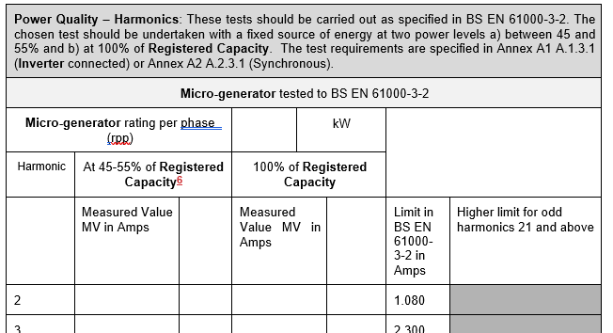
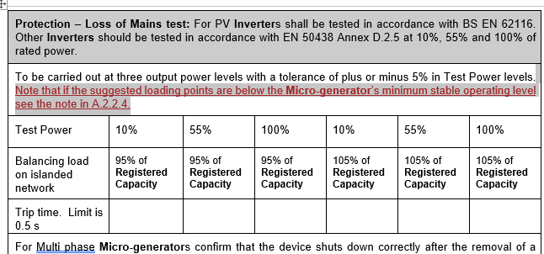
G98 Modifications
Appendix 3

Slide 54
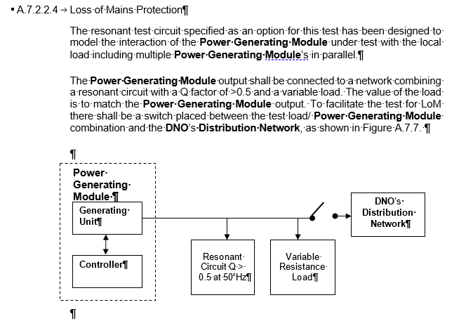
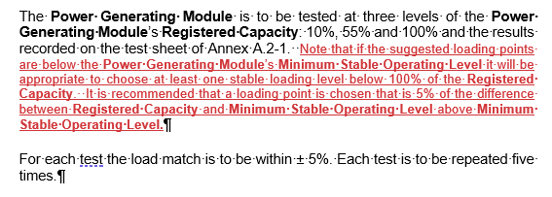
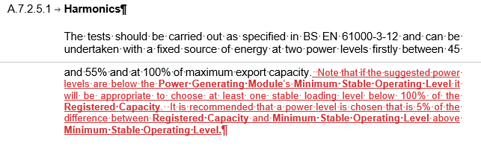
G99 Modifications

Slide 55
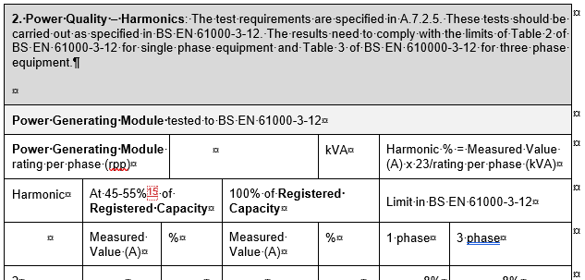
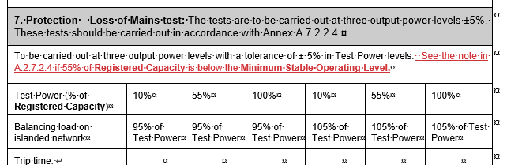
G99 – Form A2-1

Slide 56
New Issues - 2
No | Issue | Assumed Status
107 | Is a diesel rotary uninterruptable power supply (DRUPS) to be treated as a generator running in long term parallel mode? | Our understanding is that in normal operation the synchronous machine has an significant moment of inertia (flywheel) and is motoring, and that on loss of mains it then generates into the load. The connexion with the DNO’s system is interrupted by a circuit breaker, and a fast start diesel then powers the synchronous machine so it then becomes an islanded generator supplying the installation. Clearly the earthing and other arrangements need to be designed for these modes of operation. It is probably appropriate to include a reference to this as a valid instance of uncontrollable storage.

Slide 57
Unresolved Previous Issue
No | Issue | Assumed Status
101 | The issue is the LFSM-O load rejection test, and the scenario given in Appendix C7.5. For a project I have setup a test network for a Type C solar PV site, rated at 15MW and connected at 33kV which has generated some queries. Specifically: It is not clear what the ultimate aim of the test is? ie is it just to show the speed at which the inverters can de-load in the case of an over-frequency condition (ie like the equivalent Type B LFSM-O simple ramp test), or is it to show the system can actually form an island - which doesn’t make sense as the inverters do not have grid forming capability. The value ‘X’ seems to be arbitrary, and the standard wording implies that we just adjust this value until we get the required 52Hz deviation and add the generator rating to this value? Is this above assumption correct or is the value X supposed to be the Design Minimum Operating Level (DMOL)? Whilst practically a solar PV plants minimum, operating level can be very low at say 5% or less, but the inverters would not be able to handle a load rejection of 95%, and most DNO connection agreements, don’t give specific values in the way Grid connection offers do. What is the guidance for selecting the rating of the dummy generator ‘G2’, I have found that setting the value to the same rating as the site, seems to provide the correct response.. but not sure if this is correct? I have also found that it is necessary to add a simple AVR model to the dummy ‘G2’ generator to help stabilise the voltage on the islanded system… I assume this is ok, as the standard only talks about excluding the governor? What is considered a ‘pass’ for this study ie what things are you looking to see? | Still under discussion following response from NGESO

Slide 58
Update on Storage and G100

Slide 59
Storage – DCRP/MP/20/06
The DCRP has asked for the consultation to be run for eight weeks, starting this week.
There have been no significant changes to the drafting or the consultation since the report on progress to the DER Tech Forum on 03 November.

Slide 60
Distribution Code
Update to reference to remove exclusion of storage in the definition of Demand Unit
An appliance or a device whose Active Power Demand or Reactive Power production or consumption is being actively controlled by the Customer in whose Demand Facility it is installed and which has been commissioned on or after 18 August 2019 in pursuance of a contract to this end with the DNO.
Such an appliance or device commissioned before this date, but which has been materially altered will also be included in this definition.
Where there is more than one Demand Unit in a Demand Facility, these Demand Units shall together be considered as one Demand Unit if they cannot be operated independently from each other.
Demand Units of Customers where the Customer has concluded a final and binding contract for the purchase of a Demand Unit before 07 September 2018 are not included the scope of DPC9. The Customer must have notified the DNO of the conclusion of this final and binding contract by 07 March 2019.
Any Demand Unit including storage, with the exception of a pumped storage Power Generating Module, as a component part is also excluded from the requirements of DPC9

Slide 61
G98 & G99 Implementation Date
Suggested 01 September 2022
    Exclusions of Appendix 1 of G98 and Annex A4 of G99 relating to electricity storage devices would continue to apply up to this date
    This is a consultation question

Slide 62
G98 and G99 Regulatory Status and Removal of Storage Exclusions
Previous versions contained a footnote clarifying that Electricity Storage is excluded from the RfG
This will be amended such that it is clear that G98 and G99 shall be complied with for Electricity Storage irrespective of the RfG
The storage exclusions in Appendix 1 (G98) and Annex A4 (G99) have been removed from the Implementation date

Slide 63
G98 & G99 Changing to Generate on Falling Frequency, all Types
Storage device should switch to exporting, ie discharging
Positively discussed by GC0096 (but not implemented)
Proposal from the EU Stakeholder Committee Expert Group on Storage (June 2020) - expected to be included in a revision of the RfG (next couple of years)
Details on next slide
This is a consultation question

Slide 64
G98 & G99 Changing to Generate on Falling Frequency, all Types
Text, figure & new definition:
      A Power Generating Module that incorporates an Electricity Storage device must be arranged to automatically respond to falling frequency in line with the characteristic of Figure ** until the stored energy is depleted.
The required characteristics are:
a) When the frequency falls to 49.5 Hz the automatic response should start;
b) The frequency response characteristic is to be within the shaded area of Figure **;
c) If the Electricity Storage device is not capable of moving from an import level to an appropriate export level within 20 s of the frequency falling to 49 Hz, then it shall cease to import; and
d) If the Electricity Storage device has not achieved at least zero Active Power import when the frequency has reached 48.9 Hz it shall cease to import immediately.
Rated Import Capacity
The normal maximum Active Power capacity of a Power Generating Module incorporating Electricity Storage, ie the maximum possible flow of Active Power into the Power Generating Module terminals when replenishing its energy store

Slide 65
G98 & G99 Changing to Generate on Falling Frequency, all Types
Compliance – example text (similar for synchronous and other Types):
Power Park Modules which include Electricity Storage
The tests should be carried out to demonstrate how the Power Park Module Active Power when acting as a load (ie replenishing its energy store) responds to changes in system frequency.
In general, four tests are proposed, one set of two at Rated Import Capacity, and one set of two at 40% of Rated Import Capacity.
In both cases the test is to reduce frequency from 50 Hz at 2 Hzs⁻¹. In the first case the lower frequency reached will be 49.0 Hz and the second case the lower frequency will be 48.8 Hz.
In all cases the response should meet the requirements of 11.2.3.3.

Slide 66
G99 Compliance of V2G
  New text:
  Compliance of Vehicle to Grid Electric Vehicles
    The owner of the installation where a Vehicle to Grid Electric Vehicle is connected to the Distribution Network is a Generator and is responsible for compliance of the Vehicle to Grid Electric Vehicle with this EREC G99.

Slide 67
G99 Demonstration of Compliance
    New para 15.1.3 to consider combined and independent capability:
    Compliance at a Generator’s Installation with, for example:
both Electricity Storage devices and demand, or
both Power Generating Units and/or Power Generating Modules that are not Electricity Storage devices, and Electricity Storage devices,
can be demonstrated through the combined capability of all Power Generating Modules that form the Generator’s Installation. Demonstration that each Power Generating Module (including Electricity Storage devices) individually meets the requirements in this EREC G99 is required where the Generator intends to operate the Power Generating Units in their installation individually, for example, if the Electricity Storage devices are out of service.
For a Type A Power Generating Module comprised of more than one Power Generating Units with separate primary energy sources, demonstration of compliance of each group of Power Generating Units with a separate primary energy source is an acceptable method of demonstrating compliance for the Power Park Module.

Slide 68
G99 V2G
Associated new definition:
Vehicle to Grid Electric Vehicle
An electric vehicle and any associated internal or external charging devices that can import electricity from and export electricity to the Distribution Network.

Slide 69
G99 Mods to Definitions
Generating Unit
Any apparatus which produces electricity. This includes micro-generators and controllable Electricity Storage devices. A Vehicle to Grid Electric Vehicle is considered as an Electricity Storage device. Where an electric vehicle and/or its charger have been configured such that the electric vehicle cannot operate as a Vehicle to Grid Electric Vehicle, then it shall be considered as a load and is not included in the requirements of this EREC G99.
Synchronous Power Generating Module
Means an indivisible set of Generating Units (ie one or more units which cannot operate independently of each other) (including Electricity Storage devices) which can generate electrical energy such that the frequency of the generated voltage, the generator speed and the frequency of network voltage are in a constant ratio and thus in Synchronism. Each set of Generating Units which cannot run independently from each other (such as those Generating Units on a common shaft or as part of an integrated CCGT Module), but can run independent of any other generating equipment, form an individual Synchronous Power Generating Module. Any prime mover and alternator combination that can run as an independent unit (irrespective of normal operating practice) is a Synchronous Power Generating Module.

Slide 70
G99 Applicability to non-controllable storage technology
New para 7.1.3: similar logic para 7.1.2 - short term sources of energy such as regeneration and the ability of a device to support a power island for more than a few seconds:
In general the technical requirements in EREC G99 will not apply for non controllable storage technology such as synchronous compensators and synchronous flywheels. This is because there will be no need to make any specific design accommodation for such equipment as it is unlikely that they will support any possible power island for a significant length of time. Where such equipment can act as a source of electrical energy for more than a few seconds (say typically 20 s), the DNO will advise the Customer if the Customer’s Installation requires any special consideration, such as reverse power protection or short circuit current contribution assessment, on a case by case basis.

Slide 71
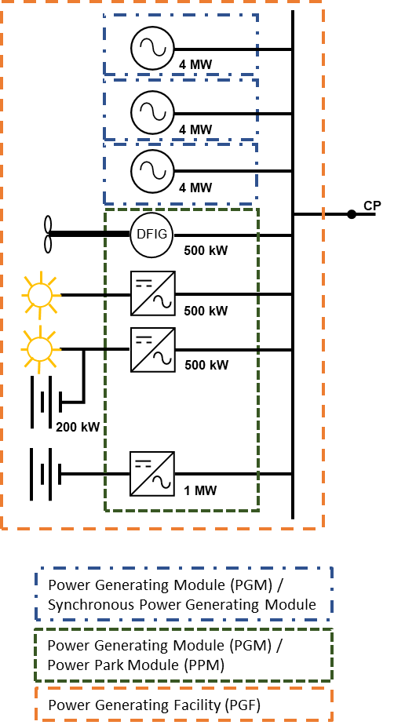
Illustrative Examples
Updated figure 4.6
3 x 4 MW Type B Gas Engines plus 1 x 500 kW asynchronous Generating Unit plus 1 x 500 kW Inverter plus 1 x 500 kW Inverter with 200 kW Integral Electricity Storage plus 1 MW Electricity Storage device
= 3 x 4 MW Type B Synchronous Power Generating Modules plus (1.5 MW + 1 MW) 2.5 MW Type B Power Park Module
= 14.5 MW Power Generating Facility (Large power station in North of Scotland)
Note the Electricity Storage device using the same Inverter as the PV does not contribute to the Power Park Module Registered Capacity, because the Registered Capacity is based on the Inverter rating. The Electricity Storage device using a dedicated Inverter is included in the Power Park Module⁶ and Power Generating Facility Registered Capacity.

Slide 72
Footnote 6
For storage commissioned before [01 September 22] please see Annex A4.2.

Slide 73
Illustrative Examples
Five new connection scenarios considering:
  additional electricity storage devices to a site with existing storage installed under EREC G83 or G59;
  additional electricity storage devices to a site with existing electricity storage devices installed under EREC G98 or G99;
  a V2G installation where the EV is connected at AC;
  a V2G installation where the EV is connected via DC; and
  a combined V2G and solar PV installation connected to a site with an existing electricity storage device

Slide 74
Additions to Table 6.1 Example connection scenarios
Scenario Number | Details of the existing Power Generating Facility | Planned expansion to the Power Generating Facility | Compliance requirements
7 | Power Park Module commissioned under EREC G98 or EREC G99 | Electricity Storage AC coupled – ie storage complete with its own Inverters Figure 6.7 | Units in the original Power Park Module and the new Electricity Storage devices⁶ aggregated to form a new single Power Generating Module. Compliance required for the new module size, with EREC G99⁸ and with operational requirements.
8 | Electricity Storage commissioned under EREC G83 or EREC G59 | Electricity Storage AC coupled – ie storage complete with its own Inverters Figure 6.8 | Original and additional Electricity Storage devices⁶ treated separately. Additional Electricity Storage devices need to comply with EREC G99; all need to comply with operational requirements.
9 | Electricity Storage commissioned under EREC G98 or EREC G99 | Electricity Storage AC coupled – ie storage complete with its own Inverters Figure 6.9 | Electricity Storage devices⁶ aggregated to form a new single Power Generating Module. Compliance required for the new module size, with EREC G99 and with operational requirements.
10 | Electricity Storage and / or Solar Power Park Module commissioned under EREC G98 or EREC G99 | Vehicle to Grid Electric Vehicle connected AC Figure 6.10 | The Inverter on board the Vehicle to Grid Electric Vehicle is a Power Generating Module⁶. The Customer is a Generator and must ensure that the Vehicle to Grid Electric Vehicle and installation is fully compliant with EREC G99.
11 | Electricity Storage and / or Solar Power Park Module commissioned under EREC G98 or EREC G99 | Vehicle to Grid Electric Vehicle connected DC Figure 6.11 | The Vehicle to Grid Electric Vehicle Inverter is a Power Generating Module⁶. The Customer is a Generator and must ensure that the Vehicle to Grid Electric Vehicle installation is fully compliant with EREC G99.
12 | Electricity Storage commissioned under EREC G98 or EREC G99 | Combined Vehicle to Grid Electric Vehicle and solar PV connected at DC Figure 6.12 | Existing Electricity Storage devices⁶ aggregated with the combined Vehicle to Grid Electric Vehicle and solar PV to form a new Power Generating Module⁶. Compliance required for the new module size, with EREC G99 and with operational requirements. The Customer is a Generator and must ensure that the Vehicle to Grid Electric Vehicle installation is fully compliant with EREC G99.

Slide 75
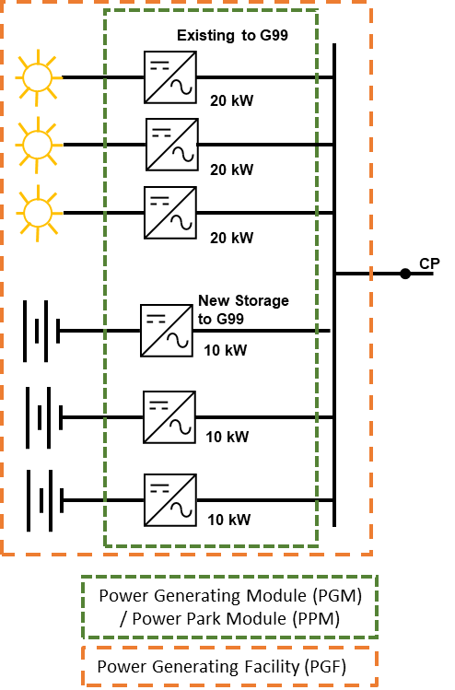
Revised Figure 6.7
Figure 6.7. Example: Existing 60 kW Type A Power Park Module to EREC G99 plus later addition of 3 x 10 kW Electricity Storage devices with own Inverters
= (60 kW + 30 kW⁶) 90 kW Type A Power Park Module
= 90 kW Power Generating Facility

Slide 76
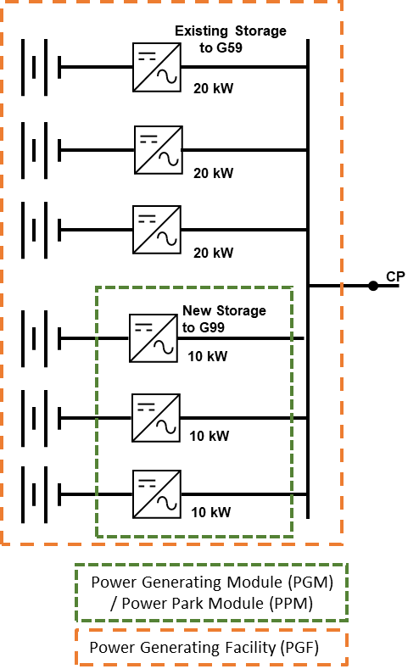
Revised Figure 6.8
Figure 6.8. Example: Existing 3 x 20 kW Electricity Storage devices to EREC G59 plus later addition of 3 x 10 kW Electricity Storage devices⁶ with own Inverters
= 60 kW Electricity Storage + 30 kW Type A Power Park Module
= 90 kW Power Generating Facility

Slide 77
Revised Figure 6.9
Figure 6.9. Example: Existing 60 kW Type A Power Park Module to EREC G99 plus later addition of 3 x 10 kW Electricity Storage devices⁶ with own Inverters
= (60 kW + 30 kW) 90 kW Type A Power Park Module
= 90 kW Power Generating Facility

Slide 78
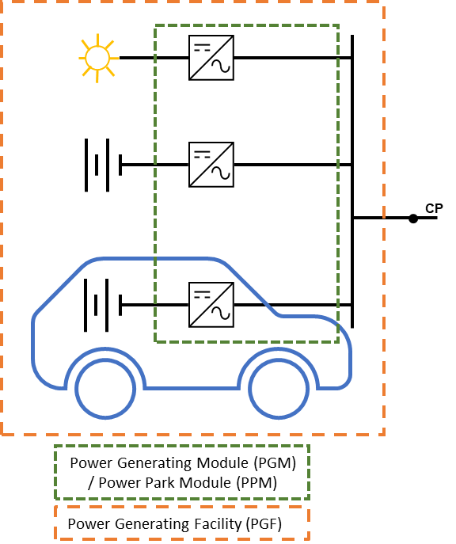
New Figure 6.10
The Vehicle to Grid Electric Vehicle is a Power Generating Unit. The Power Generating Module is comprised of the stationary Electricity Storage device, the solar PV Power Park Module and the Vehicle to Grid Electric Vehicle.
Before a Vehicle to Grid Electric Vehicle is connected to the fixed installation the Customer must ensure there is an appropriate Connection Agreement with the DNO and that the whole Power Generating Module is compliant with this EREC G99.
Figure 6.10 Example of a Vehicle to Grid Electric Vehicle where the charging device is included in the EV and there is a stationary Electricity Storage device⁶ and a solar PV Power Park Module at the same premises

Slide 79
New Figure 6.11
The Vehicle to Grid Electric Vehicle in the Customer’s Installation is a Power Generating Unit. The Power Generating Module is comprised of the stationary Electricity Storage device, the solar PV Power Park Module and the Vehicle to Grid Electric Vehicle Power Generating Unit.
Before an Vehicle to Grid Electric Vehicle is connected to the fixed installation the Customer must ensure there is an appropriate Connection Agreement with the DNO and that the whole Power Generating Module is compliant with EREC G99.
Figure 6.11 Example of a Vehicle to Grid Electric Vehicle where the Inverter is located in the Customer’s Installation and there is a stationary Electricity Storage device⁶ and a solar PV Power Park Module at the same premises

Slide 80
New Figure 6.12
The Inverter in the Vehicle to Grid Electric Vehicle is combined with the solar PV and is a Power Park Unit. The Power Generating Module is comprised of the stationary Electricity Storage device and the combined Vehicle to Grid Electric Vehicle and solar PV Power Park Unit.
Before an Vehicle to Grid Electric Vehicle is connected to the fixed installation the Customer must ensure there is an appropriate Connection Agreement with the DNO and that the Power Generating Module is compliant with EREC G99.
Figure 6.12 Example of a Vehicle to Grid Electric Vehicle with a combined Inverter also facilitating solar PV and a stationary Electricity Storage device⁶ at the same premises

Slide 81
Application forms
Record of technology type
Annex A forms A1-1 and A1-2

Slide 82
EV Connection Process
Not included in G98 and G99
New form for connection of EVs and HPs
Included in consultation for comment

Slide 83
G100
A meeting was held with stakeholders on 30 November.
Approach welcomed by stakeholders.
The significant areas for discussion etc include:
  Voltage rise limits
  Multiple G100 devices in one installation
  Communications and cybersecurity
The next meeting is 06 January 2021

Slide 84
Type Test Register etc Update

Slide 85
Wrap up:

Slide 86
Minutes of previous meeting and actions
Outstanding matters arising not on the agenda:
  None?

Slide 87
AOB and next meeting
AOB
None
Next meeting
Around March?

Slide 88
© ENA 2020

