Slide 1
Distribution Code Public Consultation – DCRP/19/03/PC – Engineering Recommendation (EREC) G5 Issue 5 (2019) – Stakeholder Engagement Dissemination Event
Name Vincent Hay
Company Energy Networks Association – Code Administrator – Distribution Code of Great Britain
Date 1st April 2019

Slide 2
Distribution Code Public Consultation – DCRP/19/03/PC – Engineering Recommendation (EREC) G5 Issue 5 (2019) – Stakeholder Engagement Dissemination Event
Agenda
10:00am - Introduction – Vincent Hay – Energy Networks Association
10:10am - Background – Forooz Ghassemi/Simon Scarbro
10:30am - Phase 1&2 – Simon Scarbro – Western Power Distribution
Lunch at 12:30pm-1:15pm
1:15pm - Phase 3 – Forooz Ghassemi – National Grid
3:00pm - Q&A – Open floor
4:00pm - Closing – Vincent Hay
Q&A will be open through each presentation however for more detailed questions, these may be answered at the conclusion of each phase

Slide 3
Distribution Code Public Consultation – DCRP/19/03/PC – Engineering Recommendation (EREC) G5 Issue 5 (2019) – Stakeholder Engagement Dissemination Event
Consultation Summary
This Distribution Code public consultation is seeking the views from industry stakeholders on the proposed modification to Engineering Recommendation G5. The proposed EREC G5 Issue 5 constitutes a full technical revision of Issue 4 published in 2005 and has been extended, amongst other things, to cover assessment for concurrent connections. This modification has been prepared under the authority of the Distribution Code Review Panel (DCRP) – EREC G5 being a Qualifying Standard and Licence Standard under the Distribution Code.
Since EREC G5 is referenced in the Grid Code, this Distribution Code Consultation is also being targeted at Grid Code users to collect feedback from the wider industry, however any change to the Grid Code to reference EREC G5 Issue 5 rather than EREC G5/4 will be considered separately under the Grid Code governance arrangements.

Slide 4
Distribution Code Public Consultation – DCRP/19/03/PC – Engineering Recommendation (EREC) G5 Issue 5 (2019) – Background
Name Forooz Ghassemi/Simon Scarbro
Company National Grid/Western Power Distribution
Date 1st April 2019

Slide 5
Distribution Code Public Consultation – DCRP/19/03/PC – Engineering Recommendation (EREC) G5 Issue 5 (2019) – Stakeholder Engagement Dissemination Event
Background
EREC G5 was published in 70s
It was revised during late 90s and published as G5/4
A revised version with minor changes was published in 2005 as G5/4-1
Work Group (WG) was set up to revise EREC G5/4-1 in 2010
A draft was published in January 2015
More than 100 comments were received
After considering the comments and feedbacks, WG with new members met in Autumn of 2015
Subgroups were formed to focus on different area in the ToR

Slide 6
Distribution Code Public Consultation – DCRP/19/03/PC – Engineering Recommendation (EREC) G5 Issue 5 (2019) – Stakeholder Engagement Dissemination Event
The original ToR
Review of other standards and practices in other countries
Possible alignment of G5/4-1 with other standards
Responsibilities and connection assessment deliverables
Data exchange between new network users and NOs
Allocation of rights, first come-first served against equal right
Treatment of connections, electrically close to each other
Measurement of the background harmonic levels and its use in the harmonic connection process
Need for management of harmonics above 50th order
Guidance on treating nodes that already have harmonics above planning levels
Interharmonics, the limits and their measurement

Slide 7
Distribution Code Public Consultation – DCRP/19/03/PC – Engineering Recommendation (EREC) G5 Issue 5 (2019) – Stakeholder Engagement Dissemination Event
Subgroups
Four subgroups were formed
  Stage 1 and Stage 2
  Stage 3
  Consideration for harmonics above 50th
  Resonant plant
Each subgroup had from two to five members, depending on the task

Slide 8
Distribution Code Public Consultation – DCRP/19/03/PC – Engineering Recommendation (EREC) G5 Issue 5 (2019) – Stakeholder Engagement Dissemination Event
Responsibility and background levels
NO facilitating a new connection is responsible for assessing new connection impact on the network and issuing harmonic specification to the new user
If (as is the normal situation) the background harmonic level is below the planning level, then the harmonic headroom is determined with respect to the planning level
If the background harmonic level is above the planning level but below the compatibility level, then the NO may specify temporary planning level up to the compatibility level
If the background harmonic level is above the compatibility level, then the NO responsible for the node shall be responsible for mitigation to reduce the background harmonic level to below the compatibility level
The NO hosting the connection shall assume that the background harmonic level is equal to the compatibility level – no harmonic headroom available – for the purpose of compliance with this document for the connection under consideration only
The above changes in planning levels shall not affect the planning level for THD_{V}

Slide 9
Distribution Code Public Consultation – DCRP/19/03/PC – Engineering Recommendation (EREC) G5 Issue 5 (2019) – Stakeholder Engagement Dissemination Event
Voltage levels and ranges
Defining voltage ranges for which the tables of planning and compatibility levels are applicable
These voltage levels have been adapted to align with typical voltages in use in the UK, which includes those used by Offshore transmission owners
The voltage ranges are:
Nominal voltage (kV)
V ≤ 0.4
0.4 < V ≤ 25
25 < V ≤ 66
66 < V ≤ 230
V > 230

Slide 10
Distribution Code Public Consultation – DCRP/19/03/PC – Engineering Recommendation (EREC) G5 Issue 5 (2019) – Stakeholder Engagement Dissemination Event
Planning and compatibility levels
Discrepancy between planning and compatibility levels in G5/4-1 and other IEC standards such as 61000-3-6 and IEEE 510 was noticed
As all of these have been in use by different utility in the world and no issue due to these levels have been reported then it was decided to increase the individual harmonic planning levels to the highest of those in different standards
As a result, planning and compatibility levels for some harmonics have raised, while keeping the planning and compatibility levels for voltage total harmonic distortion (THD) the same as G5/4-1
No planning or compatibility level has decreased compared to G5/4-1
the planning and compatibility levels are given for harmonics up to the 100th order

Slide 11
Distribution Code Public Consultation – DCRP/19/03/PC – Engineering Recommendation (EREC) G5 Issue 5 (2019) – Stakeholder Engagement Dissemination Event
Short duration harmonic burst
Guidance for limits on harmonic bursts were given mainly in ETR 122 rather than G5/4-1
This has been added to the main body of the revised G5
The rule aligns with IEC 61000-3-6
Either 3-second or 1-minute window together with 99-percentile daily values should be used
For equipment connecting at 400 V, a table is provided for power rating of motor start equipment with harmonic burst compliant with EN 60947-4-2 and EN 60947-4-3
Also, for voltages between 400 V and 25 kV, another table is provided for the rating of motor start equipment compliant with 60947-4-2 and 60947-4-3

Slide 12
Distribution Code Public Consultation – DCRP/19/03/PC – Engineering Recommendation (EREC) G5 Issue 5 (2019) – Stakeholder Engagement Dissemination Event
Harmonics above 50th order
More and more equipment with active front end, i.e. IGBT based technologies, are being connected to the public supply network at all voltage levels including EHV
ENA Report 79410, April 2013 indicates that it is prudent for utilities to be proactive and manage harmonics above 50th order
G5 sub-workgroup studied the growth of equipment with higher frequency emission and produced a technical report
The report presented that modern power electronic equipment do emit voltage/current at frequencies above 50th
The report presented a case when voltages in that range of frequencies caused equipment trip
The report recommended that these harmonics should be considered when and where practically possible, subject to discretion of relevant NO
The table of planning and compatibility levels have been extended using the equations and values for harmonics above 25th in G5/4-1 or IEC 61000-3-6, whichever was higher

Slide 13
Distribution Code Public Consultation – DCRP/19/03/PC – Engineering Recommendation (EREC) G5 Issue 5 (2019) – Stakeholder Engagement Dissemination Event
Sub-harmonic and interharmonics
Measurement aligned with IEC 61000-4-30 and IEC 61000-4-7
Interharmonics grouping are defined and used against limits
As per standards, Total Distortion Content is defined which contains all integer harmonics and interharmonic rms values
Total Distortion Ratio is the ration of TDC to rms of the fundamental
If the predicted subharmonic and interharmonic voltage emissions from an item of plant or equipment, or from a new user’s aggregate load, are less than 0.1% of the fundamental voltage, then connections may be made without any further assessment
Table 13 provides planning and compatibility levels for all voltage levels
The limits have been aligned with IEC 61000-2-2

Slide 14
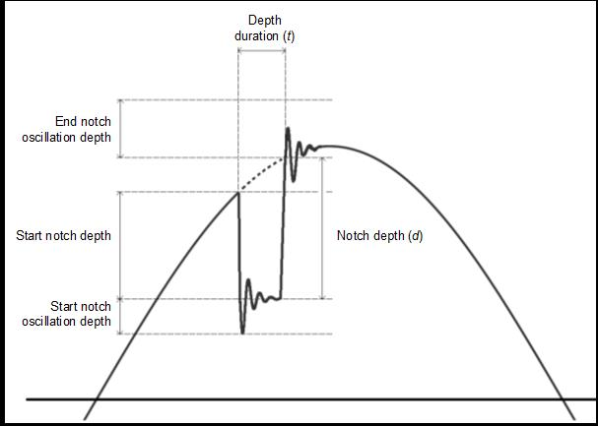
Distribution Code Public Consultation – DCRP/19/03/PC – Engineering Recommendation (EREC) G5 Issue 5 (2019) – Stakeholder Engagement Dissemination Event
Voltage notches
As per G5/4-1, aligned with IEC 61000-2-2 and 61000-2-12, for very short term effect
Limits on notch depth and peak as per G5/4-1
Limits on the duration of the notch similar to that in IEEE 519 by defining notch area

Slide 15
Distribution Code Public Consultation – DCRP/19/03/PC – Engineering Recommendation (EREC) G5 Issue 5 (2019) – Stakeholder Engagement Dissemination Event
General aggregation rule
To estimate total distortion caused by two or more sources of harmonics and considering diversity of sources, an aggregation method is needed
The rule applies mostly to the aggregation of background levels and those caused by the new user
The WG proposed adaptation of the IEC rule, that is being used in many IEC standards
It differs to aggregation rule in G5/4-1
G5/4-1
All harmonics are aggregated using RSS rule with the exception of:
The cases below where linear addition is used:
  the order with the highest magnitude in the background
  And the 5th harmonic
IEC 61000-3-6
α=1 for h ≤ 4
α=1.4 for 5 ≤ h ≤ 10
α=2 for 10 < h

Slide 16
DCRP/19/03/PC – Engineering Recommendation (EREC) G5 Issue 5 (2019) – Distribution Code Public Consultation – Stages 1 & 2
Name Simon Scarbro
Company Western Power Distribution
Date 1st April 2019

Slide 17
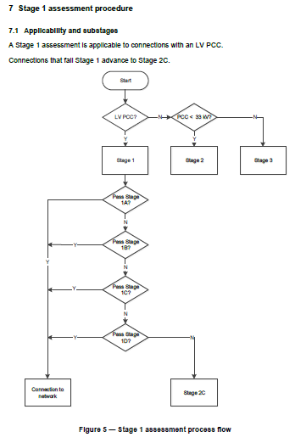
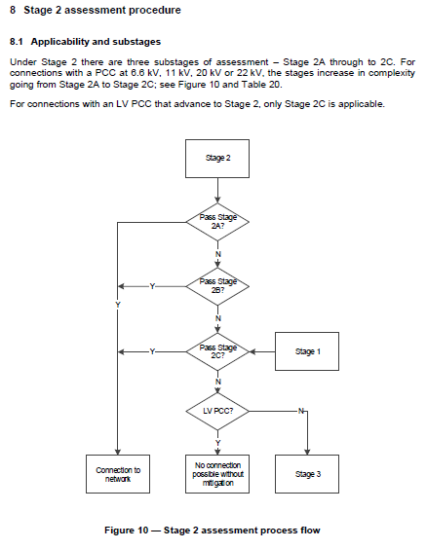
Distribution Code Public Consultation – DCRP/19/03/PC – Engineering Recommendation (EREC) G5 Issue 5 (2019) – Stakeholder Engagement Dissemination Event
Stage 1 & 2 Replacement

Slide 18
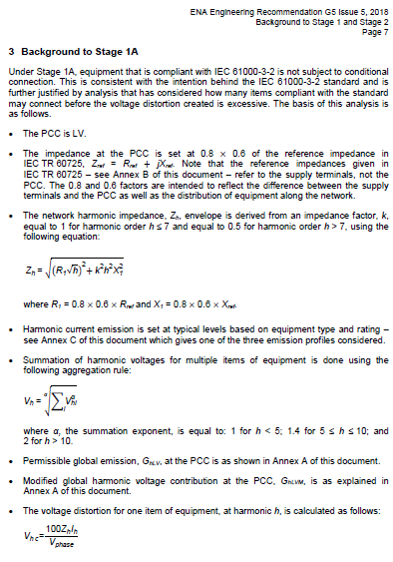
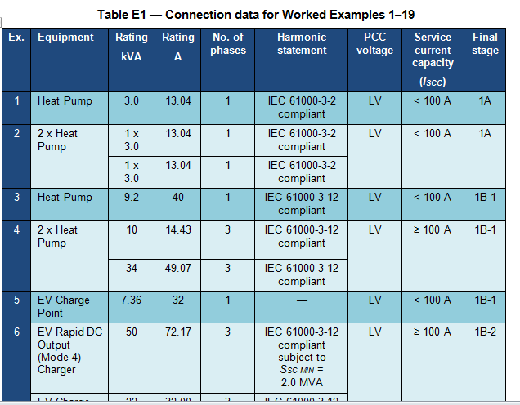
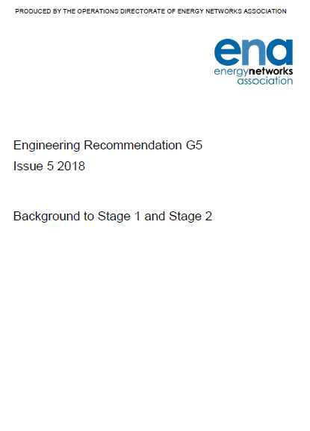
Distribution Code Public Consultation – DCRP/19/03/PC – Engineering Recommendation (EREC) G5 Issue 5 (2019) – Stakeholder Engagement Dissemination Event
ETR 122 replacement
Background to Flow Charts and Tables
Worked Examples

Slide 19
Distribution Code Public Consultation – DCRP/19/03/PC – Engineering Recommendation (EREC) G5 Issue 5 (2019) – Stakeholder Engagement Dissemination Event
Stage 1 & 2 Review Objectives
Review & update
  Standards
  Technology
  Processes
Keep complexity proportionate to risk
  Needs to be simple & easy to apply for high-volume connections

Slide 20
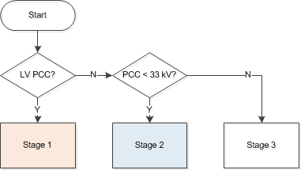
Distribution Code Public Consultation – DCRP/19/03/PC – Engineering Recommendation (EREC) G5 Issue 5 (2019) – Stakeholder Engagement Dissemination Event
G5/5 3-Stage Process

Slide 21
Distribution Code Public Consultation – DCRP/19/03/PC – Engineering Recommendation (EREC) G5 Issue 5 (2019) – Stakeholder Engagement Dissemination Event
Summary of G5/5 Stages 1 & 2
Stage 1 (1A/1B) uses standards-based assessment:
  Unconditional connection for IEC 61000-3-2 compliant equipment (1A)
  Simple assessment for IEC 61000-3-12 compliant equipment (1B)
Stage 1 (1C/1D) & 2 (2A/2B) uses technology-based assessment:
  Minimum fault level for ∑S_{equ} for common technology types
    Updated emission assumptions for converter emissions
    Active Front-end converters & 1-ph rectifiers added
Stage 2 (2C) uses actual emission-based assessment:
  V_{hp} ≤ V_{hPL} for h≤100, not just THD and 5th
  Network Operator discretion above h>50..h=100

Slide 22
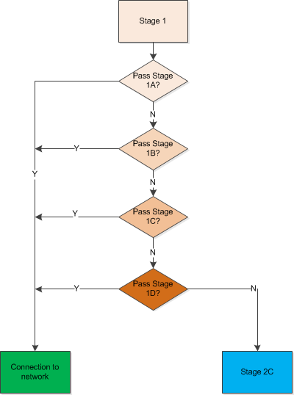
Distribution Code Public Consultation – DCRP/19/03/PC – Engineering Recommendation (EREC) G5 Issue 5 (2019) – Stakeholder Engagement Dissemination Event
Stage 1

Slide 23
Distribution Code Public Consultation – DCRP/19/03/PC – Engineering Recommendation (EREC) G5 Issue 5 (2019) – Stakeholder Engagement Dissemination Event
Stage 1
LV PCC only
4 part process -1A/1B/1C/1D
1A/1B: LV Emission Standards
  IEC 61000-3-2 – I_{equ} ≤16A
  IEC 61000-3-12 – 16A< I_{equ} ≤75A
1C/1D: kVA based assessment
  3-ph 6-pulse converter
  3-ph 12-pulse converter
  3-ph Active-front end converter
  1-ph Rectifier

Slide 24
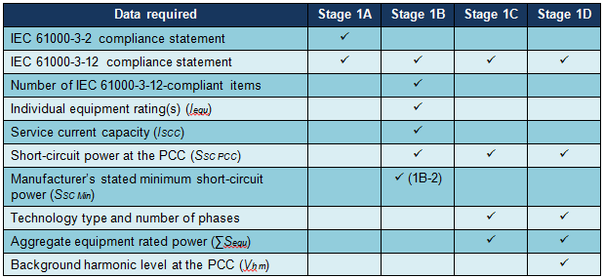
Distribution Code Public Consultation – DCRP/19/03/PC – Engineering Recommendation (EREC) G5 Issue 5 (2019) – Stakeholder Engagement Dissemination Event
Stage 1 Inputs

Slide 25
Distribution Code Public Consultation – DCRP/19/03/PC – Engineering Recommendation (EREC) G5 Issue 5 (2019) – Stakeholder Engagement Dissemination Event
Stage 1A Changes (versus G5/4-1)
Revised flow chart
Now allows unconditional connection of IEC 61000-3-2 compliant equipment
  Previously limited to aggregate of 16A

Slide 26
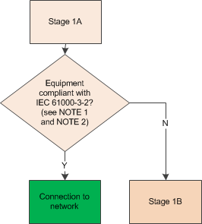
Distribution Code Public Consultation – DCRP/19/03/PC – Engineering Recommendation (EREC) G5 Issue 5 (2019) – Stakeholder Engagement Dissemination Event
Stage 1A

Slide 27

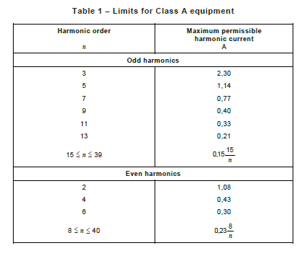
Distribution Code Public Consultation – DCRP/19/03/PC – Engineering Recommendation (EREC) G5 Issue 5 (2019) – Stakeholder Engagement Dissemination Event
Stage 1A Background

Slide 28
Distribution Code Public Consultation – DCRP/19/03/PC – Engineering Recommendation (EREC) G5 Issue 5 (2019) – Stakeholder Engagement Dissemination Event
EN 61000-3-2
This part of EN 61000 is applicable to electrical and electronic equipment having an input current equal to or less than 16 A per phase, intended to be connected to public low-voltage distribution systems of between 220 V and 250 V line to neutral at 50 Hz, and not subject to conditional connection.
Standard is ‘Harmonised’ under EMCD
Covers all manner of electrical equipment:
  Air-conditioning, heat pumps & direct water heaters
  Cookers, washing machines & tumble driers, fridges
  TVs and PCs
  Lighting
We rely on emission limits set appropriately to ensure unconditional connection is viable

Slide 29
Distribution Code Public Consultation – DCRP/19/03/PC – Engineering Recommendation (EREC) G5 Issue 5 (2019) – Stakeholder Engagement Dissemination Event
Caution! Systems Split Into Parts
EMCD: “Where apparatus is capable of taking different configurations, the EMC assessment should confirm whether the apparatus meets the essential requirements in the configurations foreseeable by the manufacturer as representative of normal use in the intended applications. In such cases it should be sufficient to perform an assessment on the basis of the configuration most likely to cause maximum disturbance and the configuration most susceptible to disturbance.”
ENA PQ & EMC Group Comment: Clearly, the final configuration of individual units, for example, in a rack, may not be known to the manufacturer and therefore it is problematical to set limits depending on configuration. However, it depends if the items are intended to be stand-alone products, or part of a system. We interpret the text from the EMCD quoted above as requiring all components designed to form a system, to be assessed together. The text, “in the configurations foreseeable by the manufacturer as representative of normal use in the intended applications”, provides additional clarity.

Slide 30
Distribution Code Public Consultation – DCRP/19/03/PC – Engineering Recommendation (EREC) G5 Issue 5 (2019) – Stakeholder Engagement Dissemination Event
Stage 1B Changes (versus G5/4-1)
Replaces G5/4-1 Section 6.3
Utilises IEC 61000-3-12 mandatory statements
  Drops reference to IEC TR 61000-3-4
Derives minimum fault level to connect, S_{SC PCC Min}
Includes for
  Mixtures of equipment complying with
    IEC 61000-3-12 and with
    IEC 61000-3-12 but subject to S_{sc} ≥X kVA
  Mixtures of equipment ratings
  No limit on number of items assessed

Slide 31
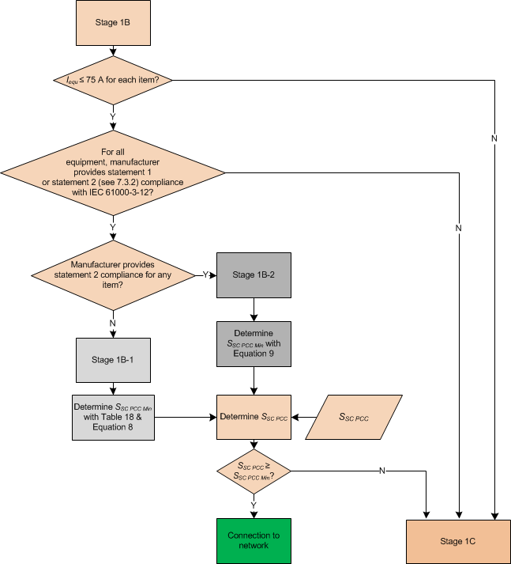
Distribution Code Public Consultation – DCRP/19/03/PC – Engineering Recommendation (EREC) G5 Issue 5 (2019) – Stakeholder Engagement Dissemination Event
Stage 1B

Slide 32

Distribution Code Public Consultation – DCRP/19/03/PC – Engineering Recommendation (EREC) G5 Issue 5 (2019) – Stakeholder Engagement Dissemination Event
Stage 1B Uses EN/IEC 61000-3-12 Manufacturer Statements
Statement Number | Statement Under EN/IEC 61000-3-12
1 | “Equipment complying with IEC 61000-3-12”
2 | “This equipment complies with IEC 61000-3-12 provided that the short-circuit power S_{sc} is greater than or equal to xx at the interface point between the connectee's supply and the public system…”
$$S_{{SC Min}_{n}}$$

Slide 33

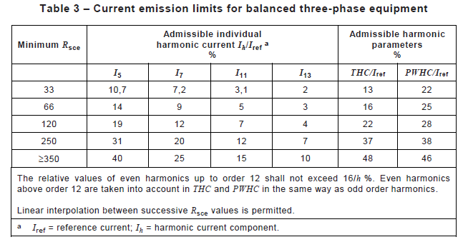
Distribution Code Public Consultation – DCRP/19/03/PC – Engineering Recommendation (EREC) G5 Issue 5 (2019) – Stakeholder Engagement Dissemination Event
Stage 1B-1 Background

Slide 34
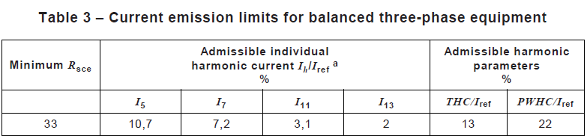
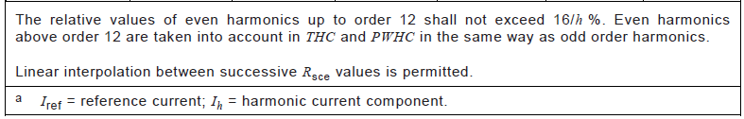
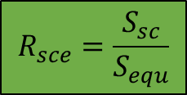
Distribution Code Public Consultation – DCRP/19/03/PC – Engineering Recommendation (EREC) G5 Issue 5 (2019) – Stakeholder Engagement Dissemination Event
EN/IEC 61000-3-12
“Equipment complying with IEC 61000-3-12”
Limits for R_{sce} = 33 equate to greater of
¼ of Compatibility Level and
IEC/EN 61000-3-2 Class B limit
$$R_{sce}=\frac{S_{sc}}{S_{equ}}$$

Slide 35
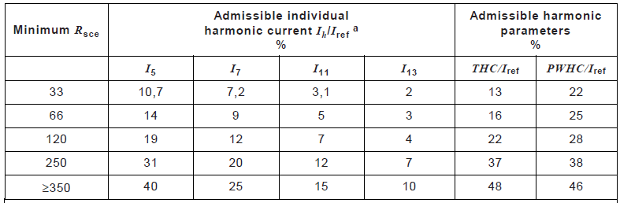
Distribution Code Public Consultation – DCRP/19/03/PC – Engineering Recommendation (EREC) G5 Issue 5 (2019) – Stakeholder Engagement Dissemination Event
EN/IEC 61000-3-12
“This equipment complies with IEC 61000-3-12 provided that the short-circuit power S_{sc} is greater than or equal to xx at the interface point between the connectee's supply and the public system…”
If limits for R_{sce} = 33 not met then
Manufacturer derives minimum R_{sce} to pass tabled limits
Manufacturer declares minimum short-circuit power required

Slide 36
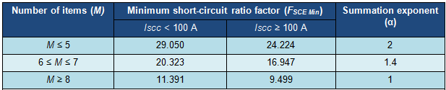

Distribution Code Public Consultation – DCRP/19/03/PC – Engineering Recommendation (EREC) G5 Issue 5 (2019) – Stakeholder Engagement Dissemination Event
Stage 1B-1
For “Equipment Complying with IEC 61000-3-12”…
$$S_{SC PCC Min}=\frac{F_{SCE Min}\sqrt[∝]{\sum_{m=1}^{M}{{S_{{equ}_{m} }}^{∝}}}}{1000}$$

Slide 37
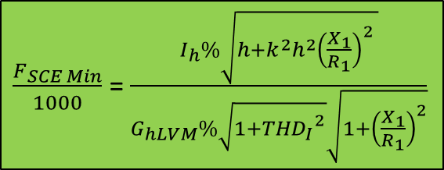
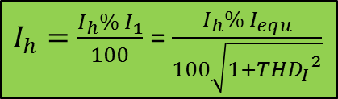
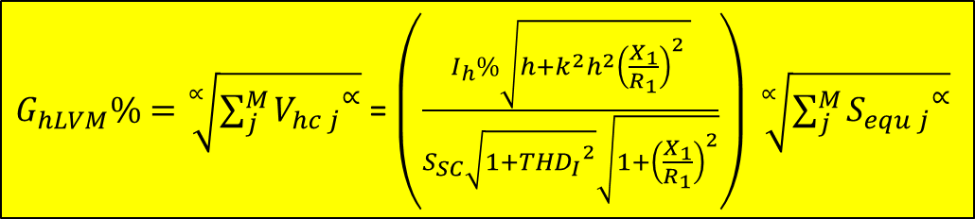
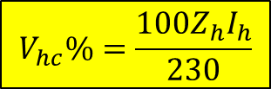
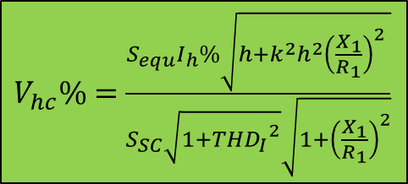

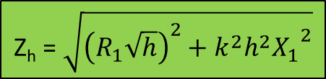
Distribution Code Public Consultation – DCRP/19/03/PC – Engineering Recommendation (EREC) G5 Issue 5 (2019) – Stakeholder Engagement Dissemination Event
Stage 1B-1 Background!
$$\text{Z}\text{h}\text{ = }\sqrt{{\left(R_{1}\sqrt{h}\right)}^{2}+{{{k^{2}h}^{2}X}_{1}}^{2}}$$
$V_{hc}\%=$ $\frac{S_{equ}I_{h}\%\sqrt{h+{{k^{2}h}^{2}\left(\frac{X_{1}}{R_{1}}\right)}^{2} }}{S_{SC}\sqrt{1+{{THD}_{I}}^{2}}\sqrt{1+{\left(\frac{X_{1}}{R_{1}}\right)}^{2}}}$
$I_{h}=\frac{I_{h}\% I_{1}}{100}$ = $\frac{{I_{h}\% I}_{equ}}{100\sqrt{1+{{THD}_{I}}^{2}}}$
$$V_{hc}\%=\frac{{100Z}_{h}I_{h}}{230}$$
$G_{hLVM}\%=\sqrt[∝]{\sum_{j}^{M}{{V_{hc j}}^{∝}}}$ = $\left(\frac{I_{h}\%\sqrt{h+{{k^{2}h}^{2}\left(\frac{X_{1}}{R_{1}}\right)}^{2} }}{S_{SC}\sqrt{1+{{THD}_{I}}^{2}}\sqrt{1+{\left(\frac{X_{1}}{R_{1}}\right)}^{2}}}\right) \sqrt[∝]{\sum_{j}^{M}{{S_{equ j}}^{∝}}}$
$\frac{F_{SCE Min}}{1000}$ = $\frac{I_{h}\%\sqrt{h+{{k^{2}h}^{2}\left(\frac{X_{1}}{R_{1}}\right)}^{2} }}{G_{hLVM}\%\sqrt{1+{{THD}_{I}}^{2}}\sqrt{1+{\left(\frac{X_{1}}{R_{1}}\right)}^{2}}}$
$$S_{SC PCC Min}=\frac{F_{SCE Min}\sqrt[∝]{\sum_{m=1}^{M}{{S_{{equ}_{m} }}^{∝}}}}{1000}$$

Slide 38

Stage 1B-2
For “Equipment Complying with IEC 61000-3-12 subject to S_{SC Min}” with/without “Equipment Complying with IEC 61000-3-12”…
$$S_{SC PCC Min}=33\sum_{m=1}^{M}{S_{{equ}_{m}}}+\sum_{n=1}^{N}{S_{{SC Min}_{n}}}$$
“Equipment Complying with IEC 61000-3-12”
“Equipment Complying with IEC 61000-3-12 Subject to S_{SC Min} ≥X MVA”
Distribution Code Public Consultation – DCRP/19/03/PC – Engineering Recommendation (EREC) G5 Issue 5 (2019) – Stakeholder Engagement Dissemination Event

Slide 39

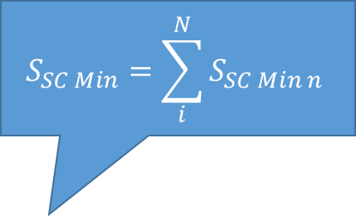
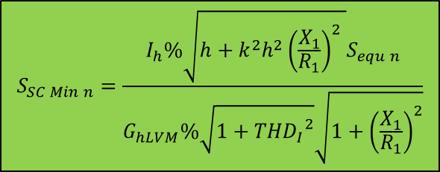
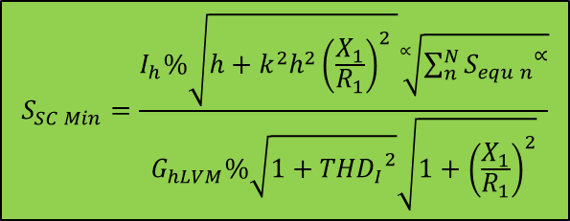
$$S_{SC Min}=\frac{I_{h}\%\sqrt{h+{{k^{2}h}^{2}\left(\frac{X_{1}}{R_{1}}\right)}^{2} }\sqrt[∝]{\sum_{n}^{N}{{S_{equ n}}^{∝}}}}{G_{hLVM}\%\sqrt{1+{{THD}_{I}}^{2}}\sqrt{1+{\left(\frac{X_{1}}{R_{1}}\right)}^{2}}}$$
Stage 1B-2 Background
$$S_{SC Min n}=\frac{I_{h}\%\sqrt{h+{{k^{2}h}^{2}\left(\frac{X_{1}}{R_{1}}\right)}^{2} }S_{equ n}}{G_{hLVM}\%\sqrt{1+{{THD}_{I}}^{2}}\sqrt{1+{\left(\frac{X_{1}}{R_{1}}\right)}^{2}}}$$
“Equipment Complying with IEC 61000-3-12” is based on S_{SC PCC}/S_{equ} = 33
$$S_{SC Min}=\sum_{i}^{N}{S_{SC Min n}}$$
$$S_{SC PCC Min}=33\sum_{m=1}^{M}{S_{{equ}_{m}}}+\sum_{n=1}^{N}{S_{{SC Min}_{n}}}$$
Distribution Code Public Consultation – DCRP/19/03/PC – Engineering Recommendation (EREC) G5 Issue 5 (2019) – Stakeholder Engagement Dissemination Event

Slide 40
Stage 1C Changes (versus G5/4-1)
Replaces G5/4-1 Section 6.3.1.2 & Table 6
  Split into Stages 1C-1 & 1C-2
Stage 1C-1
  Derives max. permitted aggregate equipment rating, ∑_{equ permitted}, connectable for given fault level at PCC, S_{SC PCC}
  3-ph 6-p/12-p/AFE converters/1-ph rectifiers
  Impact of THDi and skin effect included
    Higher ratings now possible without further study
Stage 1C-2
  Derives minimum fault level , S_{SC PCC Min}, to connect mixed 3-ph 6-p/AFE converters
Distribution Code Public Consultation – DCRP/19/03/PC – Engineering Recommendation (EREC) G5 Issue 5 (2019) – Stakeholder Engagement Dissemination Event

Slide 41
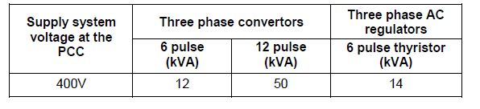
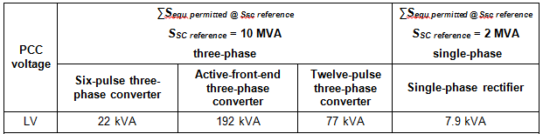
Stage 1C Changes (versus G5/4-1)
EREC G5/4-1
EREC G5/5
Distribution Code Public Consultation – DCRP/19/03/PC – Engineering Recommendation (EREC) G5 Issue 5 (2019) – Stakeholder Engagement Dissemination Event

Slide 42
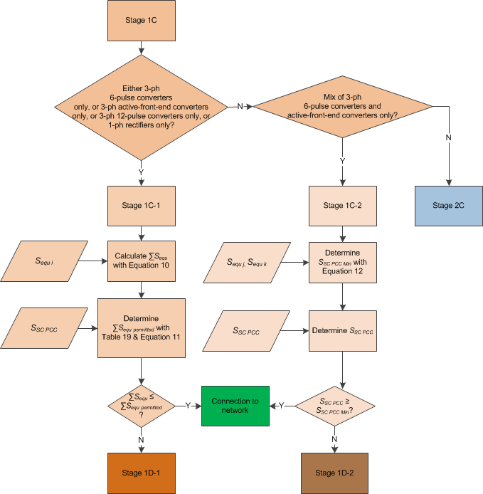
Stage 1C
Distribution Code Public Consultation – DCRP/19/03/PC – Engineering Recommendation (EREC) G5 Issue 5 (2019) – Stakeholder Engagement Dissemination Event

Slide 43

Stage 1C-1
V_{s} @ PCC | ∑ S_{equ permitted @ reference Ssc} (S_{SC reference} = 10MVA 3-ph) |  |  | ∑ S_{equ permitted @ reference Ssc} (S_{SC reference} = 2 MVA 1-ph)
 | 6-pulse 3-phase converter | Active Front-end 3-phase converter | 12-pulse 3-phase converter | Rectifier 1-phase
LV | 22 kVA | 192 kVA | 77 kVA | 7.4 kVA
$$\sum{S_{equ permitted}} = S_{SC PCC}\left(\frac{\sum{S_{equ permitted @ reference Ssc}}}{S_{SC Reference}}\right)$$
Distribution Code Public Consultation – DCRP/19/03/PC – Engineering Recommendation (EREC) G5 Issue 5 (2019) – Stakeholder Engagement Dissemination Event

Slide 44
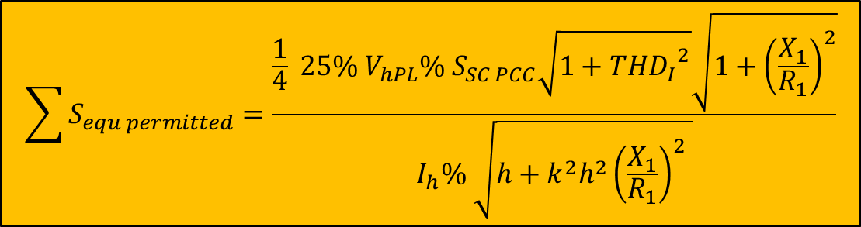
Stage 1C-1 Background – 3-phase
$$\sum{S_{equ permitted}}=\frac{\frac{1}{4}{ 25\% V}_{hPL}\% S_{SC PCC}\sqrt{1+{{THD}_{I}}^{2}}\sqrt{1+{\left(\frac{X_{1}}{R_{1}}\right)}^{2}}}{I_{h}\% \sqrt{h+{{k^{2}h}^{2}\left(\frac{X_{1}}{R_{1}}\right)}^{2} }}$$
V_{s} @ PCC | ∑ S_{equ permitted @ reference Ssc} (S_{SC reference} = 10MVA 3-ph)
 | 6-pulse 3-phase converter | Active Front-end 3-phase converter | 12-pulse 3-phase converter
LV | 22 kVA | 192 kVA | 77 kVA
Distribution Code Public Consultation – DCRP/19/03/PC – Engineering Recommendation (EREC) G5 Issue 5 (2019) – Stakeholder Engagement Dissemination Event

Slide 45
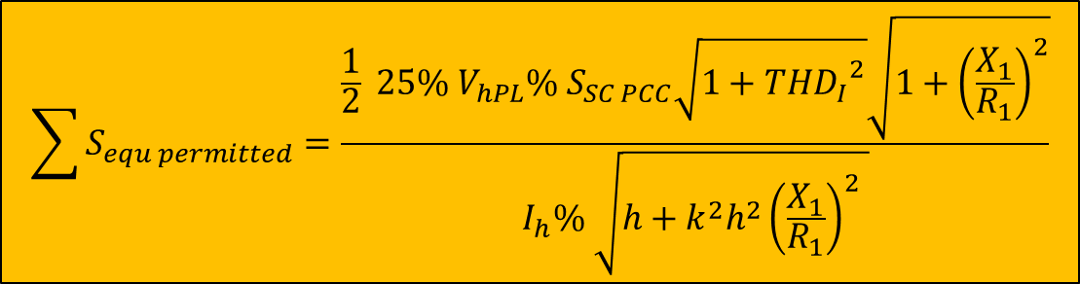
Stage 1C-1 Background – 1-phase
$$\sum{S_{equ permitted}}=\frac{\frac{1}{2}{ 25\% V}_{hPL}\% S_{SC PCC}\sqrt{1+{{THD}_{I}}^{2}}\sqrt{1+{\left(\frac{X_{1}}{R_{1}}\right)}^{2}}}{I_{h}\% \sqrt{h+{{k^{2}h}^{2}\left(\frac{X_{1}}{R_{1}}\right)}^{2} }}$$
V_{s} @ PCC | ∑ S_{equ permitted @ reference Ssc} (S_{SC reference} = 2 MVA 1-ph)
 | Rectifier 1-phase
LV | 7.4 kVA
Distribution Code Public Consultation – DCRP/19/03/PC – Engineering Recommendation (EREC) G5 Issue 5 (2019) – Stakeholder Engagement Dissemination Event

Slide 46

Stage 1C-2
For mixed 6-pulse and Active Front-end equipment…
$$S_{SC PCC Min}=459.977\sum_{j=1}^{J}{S_{{equ}_{j}}}+52.170 \sum_{k=1}^{K}{S_{{equ}_{k}}}$$
6-pulse
Active Front-end
Distribution Code Public Consultation – DCRP/19/03/PC – Engineering Recommendation (EREC) G5 Issue 5 (2019) – Stakeholder Engagement Dissemination Event

Slide 47


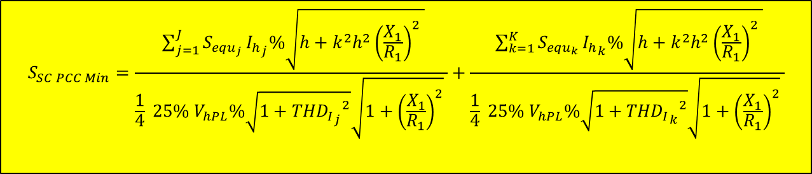
Stage 1C-2 Background
$$S_{SC PCC Min}=\frac{ \sum_{j=1}^{J}{S_{{equ}_{j}}}{I_{h}}_{j}\%\sqrt{h+{{k^{2}h}^{2}\left(\frac{X_{1}}{R_{1}}\right)}^{2} }}{\frac{1}{4}{ 25\% V}_{hPL}\%\sqrt{1+{{{THD}_{I}}_{j}}^{2}}\sqrt{1+{\left(\frac{X_{1}}{R_{1}}\right)}^{2}} }+\frac{ \sum_{k=1}^{K}{S_{{equ}_{k}}}{I_{h}}_{k}\%\sqrt{h+{{k^{2}h}^{2}\left(\frac{X_{1}}{R_{1}}\right)}^{2} }}{\frac{1}{4}{ 25\% V}_{hPL}\%\sqrt{1+{{{THD}_{I}}_{k}}^{2}}\sqrt{1+{\left(\frac{X_{1}}{R_{1}}\right)}^{2}} }$$
$$S_{SC PCC Min}=\frac{ \sum_{j=1}^{J}{S_{{equ}_{j}}}31.4\%\sqrt{5+{{1^{2}5}^{2}\left(1.0\right)}^{2} }}{\frac{1}{4} x 0.25 x 4\%\sqrt{1+{0.3441}^{2}}\sqrt{1+{\left(1.0\right)}^{2}} }+\frac{ \sum_{k=1}^{K}{S_{{equ}_{k}}}3.37\%\sqrt{5+{{1^{2}5}^{2}\left(1.0\right)}^{2} }}{\frac{1}{4}x 0.25 x 4\%\sqrt{1+{0.038067}^{2}}\sqrt{1+{\left(1.0\right)}^{2}} }$$
$$S_{SC PCC Min}=459.977\sum_{j=1}^{J}{S_{{equ}_{j}}}+52.170 \sum_{k=1}^{K}{S_{{equ}_{k}}}$$
Distribution Code Public Consultation – DCRP/19/03/PC – Engineering Recommendation (EREC) G5 Issue 5 (2019) – Stakeholder Engagement Dissemination Event

Slide 48
Stage 1D Changes (versus G5/4-1)
New approach (not used before)
  Split into Stages 1D-1 & 1D-2
  Background measurement of limiting harmonic used
  Headroom derived & used in calculation
Stage 1D-1
  Modified version of Stage 1C-1
  Max. permitted aggregate equipment rating, ∑_{equ permitted}, connectable for given fault level at PCC, S_{SC PCC}, derived
Stage 1D-2
  Modified version of Stage 1C-2
  Derives minimum fault level , S_{SC PCC Min}, to connect mixed 3-ph 6-p/AFE converters
Distribution Code Public Consultation – DCRP/19/03/PC – Engineering Recommendation (EREC) G5 Issue 5 (2019) – Stakeholder Engagement Dissemination Event

Slide 49
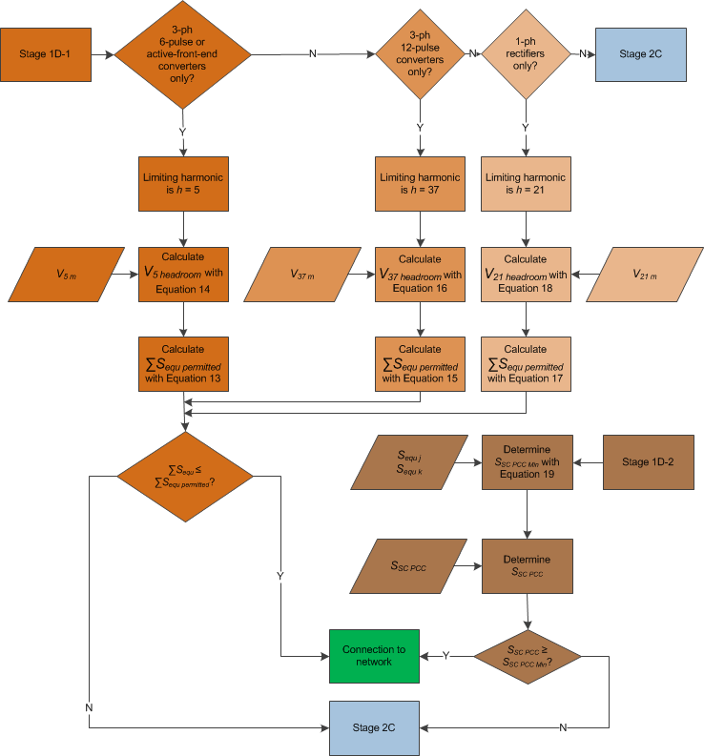
Stage 1D
Distribution Code Public Consultation – DCRP/19/03/PC – Engineering Recommendation (EREC) G5 Issue 5 (2019) – Stakeholder Engagement Dissemination Event

Slide 50
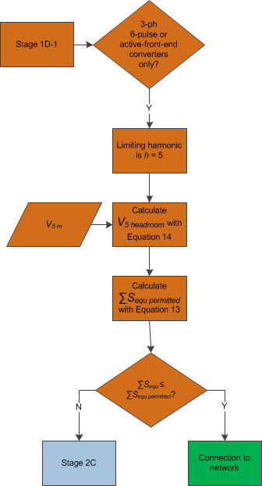
Stage 1D-1 (part)
Distribution Code Public Consultation – DCRP/19/03/PC – Engineering Recommendation (EREC) G5 Issue 5 (2019) – Stakeholder Engagement Dissemination Event

Slide 51
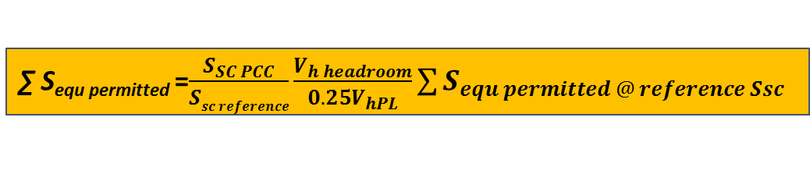

Stage 1D-1
As Stage 1C-1 but…
  ∑S_{equ permitted} scaled for headroom
    NOTE ∑S_{equ permitted} increased if V_{hm} < 75% V_{hPL}
  Headroom V_{h headroom} based on:
  6-p/AFE: h=5
  12-p: h=37
  1-ph rectifier: h=21
$$V_{h headroom}=V_{hPL}−V_{hm}$$
∑ S_{equ permitted} =$\frac{S_{SC PCC}}{Ssc reference}\frac{V_{h headroom}}{0.25V_{hPL}}\sum{S_{equ permitted @ reference Ssc}}$
Distribution Code Public Consultation – DCRP/19/03/PC – Engineering Recommendation (EREC) G5 Issue 5 (2019) – Stakeholder Engagement Dissemination Event

Slide 52
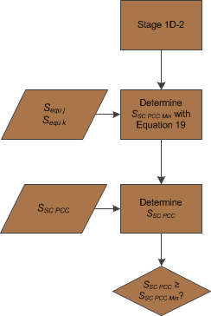
Stage 1D-2
Distribution Code Public Consultation – DCRP/19/03/PC – Engineering Recommendation (EREC) G5 Issue 5 (2019) – Stakeholder Engagement Dissemination Event

Slide 53


Stage 1D-2
As Stage 1C-2 but…
  ∑S_{SC PCC Min} scaled for headroom
    NOTE ∑S_{SC} _{PCC Min} increased if V_{5m} < 75% V_{5PL}
For mixed 6-pulse and Active Front-end equipment…
6-pulse
Active Front-end
$$S_{SC PCC Min}=\frac{459.977\sum_{j=1}^{J}{{S_{equ}}_{j}} +52.170\sum_{k=1}^{K}{S_{{equ}_{k}}}}{V_{5 headroom}\%}$$
$$V_{5 headroom}=V_{5PL}−V_{5m}$$
Distribution Code Public Consultation – DCRP/19/03/PC – Engineering Recommendation (EREC) G5 Issue 5 (2019) – Stakeholder Engagement Dissemination Event

Slide 54
Note
Note that the proposals omit a table of permitted harmonic currents like in Table 7 of G5/4-1.
NB In Stage 2C: “Note 1: To facilitate rapid assessment, it is permissible to assume that background harmonic distortion does not exceed 75% of the Planning Level subject to the agreement of the relevant Network Operator.”
Distribution Code Public Consultation – DCRP/19/03/PC – Engineering Recommendation (EREC) G5 Issue 5 (2019) – Stakeholder Engagement Dissemination Event

Slide 55
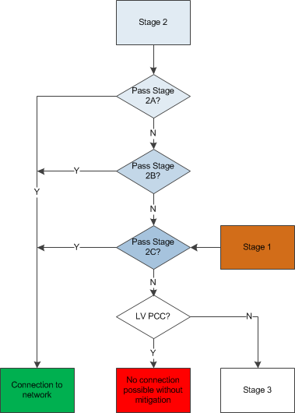
Stage 2
HV PCC
LV PCC failed Stage 1
3 part process -2A/2B/2C
2A & 2B
  kVA based assessment
    3-ph 6-pulse
    3-ph 12-pulse
    3-ph Active-front end
Distribution Code Public Consultation – DCRP/19/03/PC – Engineering Recommendation (EREC) G5 Issue 5 (2019) – Stakeholder Engagement Dissemination Event

Slide 56
Stage 2
Data Required | Stage 2A | Stage 2B | Stage 2C
∑ S_{equ}
S_{SC PCC}
Technology type
V_{hm PCC}
I_{h}
Distribution Code Public Consultation – DCRP/19/03/PC – Engineering Recommendation (EREC) G5 Issue 5 (2019) – Stakeholder Engagement Dissemination Event

Slide 57
Stage 2A Changes (versus G5/4-1)
Replaces G5/4-1 Section & Table 10
Split into Stages 2A-1 and 2A-2
Stage 2A-1
  Derives max. permitted aggregate equipment rating, ∑_{equ permitted}, connectable for given fault level at PCC, S_{SC PCC}
  3-ph 6-p/12-p/AFE converters
  Impact of THDi and skin effect included
    Higher ratings now possible without further study
Stage 2A-2
    Derives minimum fault level , S_{SC PCC Min}, to connect mixed 3-ph 6-p/AFE converters
Distribution Code Public Consultation – DCRP/19/03/PC – Engineering Recommendation (EREC) G5 Issue 5 (2019) – Stakeholder Engagement Dissemination Event

Slide 58
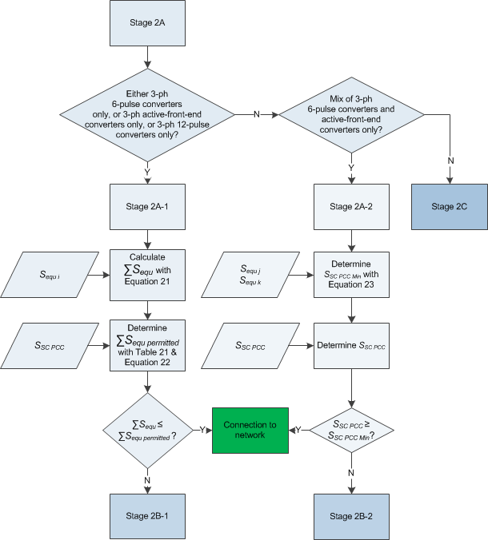
Stage 2A
Distribution Code Public Consultation – DCRP/19/03/PC – Engineering Recommendation (EREC) G5 Issue 5 (2019) – Stakeholder Engagement Dissemination Event

Slide 59
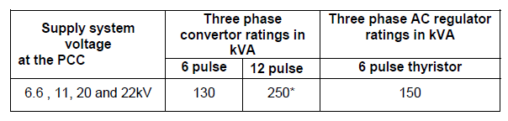
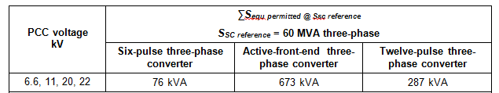
Stage 2A-1 Changes (versus G5/4-1)
100MVA basis
78 kVA
150kVA
60MVA basis
60MVA basis
Distribution Code Public Consultation – DCRP/19/03/PC – Engineering Recommendation (EREC) G5 Issue 5 (2019) – Stakeholder Engagement Dissemination Event

Slide 60

Stage 2A-1
Mirrors Stage 1C
Allocation=25%V_{hPL}
Reference S_{sc} = 60MVA
Voltage @ PCC | ∑ Sequ permitted @ 60MVA reference Ssc
 | 6-pulse 3-phase converter | Active Front-end 3-phase converter | 12-pulse 3-phase converter
6.6/11/20/22kV | 76 kVA | 673 kVA | 287 kVA
$\sum{S_{equ permitted}} = S_{SC PCC}\left(\frac{\sum{S_{equ permitted @ 60MVA reference Ssc}}}{60MVA}\right)$
Distribution Code Public Consultation – DCRP/19/03/PC – Engineering Recommendation (EREC) G5 Issue 5 (2019) – Stakeholder Engagement Dissemination Event

Slide 61
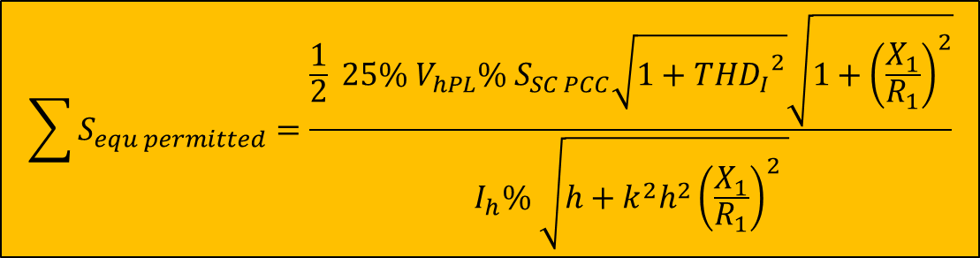
Stage 2A-1 Background
$$\sum{S_{equ permitted}}=\frac{\frac{1}{2}{ 25\% V}_{hPL}\% S_{SC PCC}\sqrt{1+{{THD}_{I}}^{2}}\sqrt{1+{\left(\frac{X_{1}}{R_{1}}\right)}^{2}}}{I_{h}\% \sqrt{h+{{k^{2}h}^{2}\left(\frac{X_{1}}{R_{1}}\right)}^{2} }}$$
Voltage @ PCC | ∑ Sequ permitted @ 60MVA reference Ssc
 | 6-pulse 3-phase converter | Active Front-end 3-phase converter | 12-pulse 3-phase converter
6.6/11/20/22kV | 76 kVA | 673 kVA | 287 kVA
Distribution Code Public Consultation – DCRP/19/03/PC – Engineering Recommendation (EREC) G5 Issue 5 (2019) – Stakeholder Engagement Dissemination Event

Slide 62

Stage 2A-2
For mixed 6-pulse and Active Front-end equipment…
$$S_{SC PCC Min}=785.962\sum_{j=1}^{J}{S_{{equ}_{j}}}+89.143 \sum_{k=1}^{K}{S_{{equ}_{k}}}$$
6-pulse
Active Front-end
Distribution Code Public Consultation – DCRP/19/03/PC – Engineering Recommendation (EREC) G5 Issue 5 (2019) – Stakeholder Engagement Dissemination Event

Slide 63

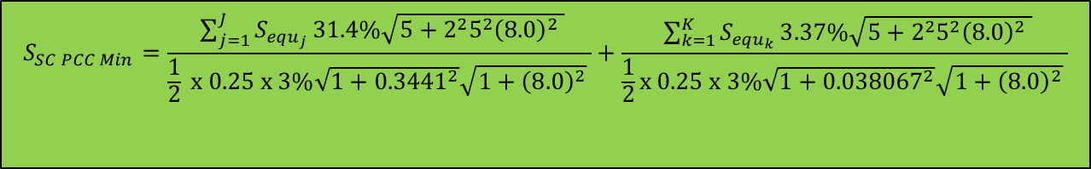
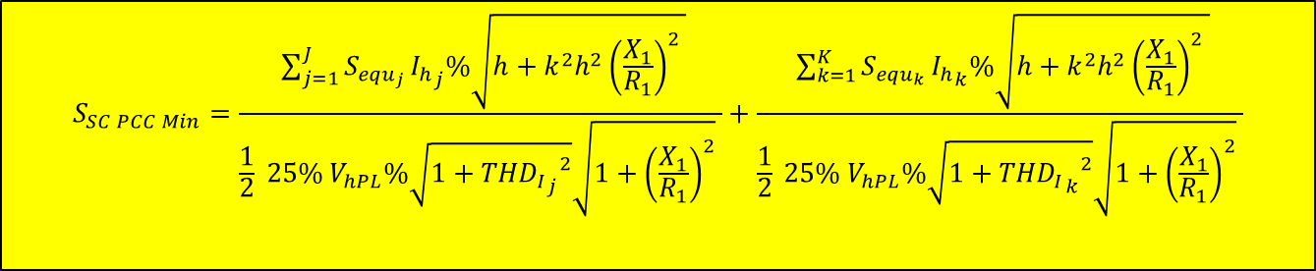
Stage 2A-2 Background
$$S_{SC PCC Min}=\frac{ \sum_{j=1}^{J}{S_{{equ}_{j}}}{I_{h}}_{j}\%\sqrt{h+{{k^{2}h}^{2}\left(\frac{X_{1}}{R_{1}}\right)}^{2} }}{\frac{1}{2}{ 25\% V}_{hPL}\%\sqrt{1+{{{THD}_{I}}_{j}}^{2}}\sqrt{1+{\left(\frac{X_{1}}{R_{1}}\right)}^{2}} }+\frac{ \sum_{k=1}^{K}{S_{{equ}_{k}}}{I_{h}}_{k}\%\sqrt{h+{{k^{2}h}^{2}\left(\frac{X_{1}}{R_{1}}\right)}^{2} }}{\frac{1}{2}{ 25\% V}_{hPL}\%\sqrt{1+{{{THD}_{I}}_{k}}^{2}}\sqrt{1+{\left(\frac{X_{1}}{R_{1}}\right)}^{2}} }$$
$$S_{SC PCC Min}=\frac{ \sum_{j=1}^{J}{S_{{equ}_{j}}}31.4\%\sqrt{5+{{2^{2}5}^{2}\left(8.0\right)}^{2} }}{\frac{1}{2} x 0.25 x 3\%\sqrt{1+{0.3441}^{2}}\sqrt{1+{\left(8.0\right)}^{2}} }+\frac{ \sum_{k=1}^{K}{S_{{equ}_{k}}}3.37\%\sqrt{5+{{2^{2}5}^{2}\left(8.0\right)}^{2} }}{\frac{1}{2}x 0.25 x 3\%\sqrt{1+{0.038067}^{2}}\sqrt{1+{\left(8.0\right)}^{2}} }$$
$$S_{SC PCC Min}=785.962\sum_{j=1}^{J}{S_{{equ}_{j}}}+89.143 \sum_{k=1}^{K}{S_{{equ}_{k}}}$$
Distribution Code Public Consultation – DCRP/19/03/PC – Engineering Recommendation (EREC) G5 Issue 5 (2019) – Stakeholder Engagement Dissemination Event

Slide 64
Stage 2B Changes (versus G5/4-1)
New approach (not used before)
  Split into Stages 2B-1 & 2B-2
  Background measurement of limiting harmonic used
  Headroom derived & used in calculation
Stage 2B-1
  Modified version of Stage 2A-1
  Max. permitted aggregate equipment rating, ∑_{equ permitted}, connectable for given fault level at PCC, S_{SC PCC}, derived
Stage 2B-2
  Modified version of Stage 2B-2
  Derives minimum fault level , S_{SC PCC Min}, to connect mixed 3-ph 6-p/AFE converters
Distribution Code Public Consultation – DCRP/19/03/PC – Engineering Recommendation (EREC) G5 Issue 5 (2019) – Stakeholder Engagement Dissemination Event

Slide 65
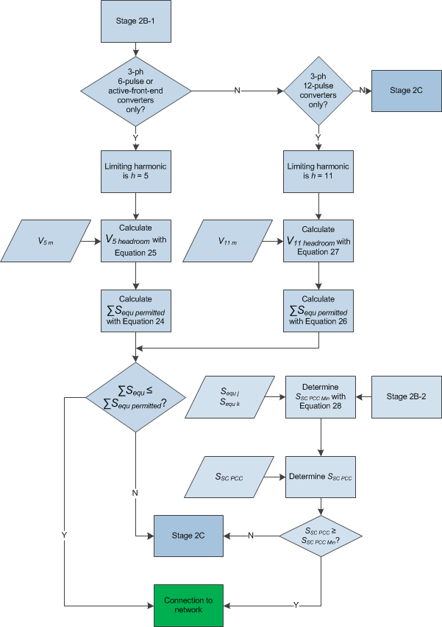
Stage 2B
Distribution Code Public Consultation – DCRP/19/03/PC – Engineering Recommendation (EREC) G5 Issue 5 (2019) – Stakeholder Engagement Dissemination Event

Slide 66
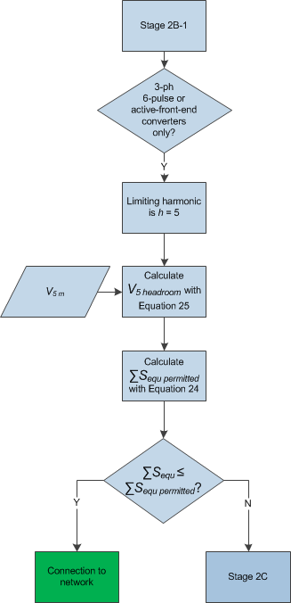
Stage 2B-1 (part)
Distribution Code Public Consultation – DCRP/19/03/PC – Engineering Recommendation (EREC) G5 Issue 5 (2019) – Stakeholder Engagement Dissemination Event

Slide 67
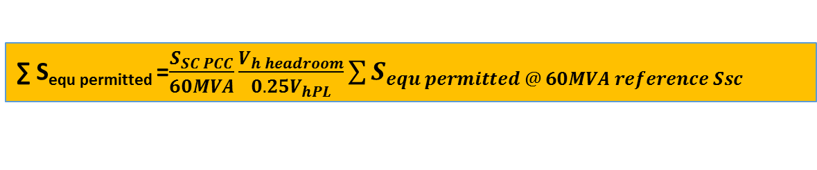

Stage 2B-1
Mirrors Stage 1D-1
As Stage 2A-1 but…
  ∑S_{equ permitted} scaled for headroom
    NOTE ∑S_{equ permitted} increased if V_{hm} < 75% V_{hPL}
  Headroom V_{h headroom} based on:
  6-p/AFE: h=5
  12-p: h=11
$$V_{h headroom}=V_{hPL}−V_{hm}$$
∑ S_{equ permitted} =$\frac{S_{SC PCC}}{60MVA}\frac{V_{h headroom}}{0.25V_{hPL}}\sum{S_{equ permitted @ 60MVA reference Ssc}}$
Distribution Code Public Consultation – DCRP/19/03/PC – Engineering Recommendation (EREC) G5 Issue 5 (2019) – Stakeholder Engagement Dissemination Event

Slide 68
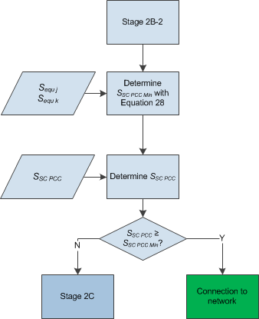
Stage 2B-2
Distribution Code Public Consultation – DCRP/19/03/PC – Engineering Recommendation (EREC) G5 Issue 5 (2019) – Stakeholder Engagement Dissemination Event

Slide 69


Stage 2B-2
As Stage 2A-2 but…
  ∑S_{SC PCC Min} scaled for headroom
    NOTE ∑S_{SC} _{PCC Min} increased if V_{5m} < 75% V_{5PL}
For mixed 6-pulse and Active Front-end equipment…
6-pulse
Active Front-end
$$S_{SC PCC Min}=\frac{589.472\sum_{j=1}^{J}{S_{{equ}_{j}}}+66.857 \sum_{k=1}^{K}{S_{{equ}_{k}}}}{{ V}_{5 headroom}\%}$$
$$V_{5 headroom}=V_{5PL}−V_{5m}$$
Distribution Code Public Consultation – DCRP/19/03/PC – Engineering Recommendation (EREC) G5 Issue 5 (2019) – Stakeholder Engagement Dissemination Event

Slide 70
Stage 2C Changes (versus G5/4-1)
  Similar to original final part of Stage 2 but
    Impact of THD_{I} and skin effect included
    All harmonic orders (& THD_{V}) checked rather than just 5th (& THD_{V})
    Harmonics orders 51..100 at discretion of NO
Distribution Code Public Consultation – DCRP/19/03/PC – Engineering Recommendation (EREC) G5 Issue 5 (2019) – Stakeholder Engagement Dissemination Event

Slide 71
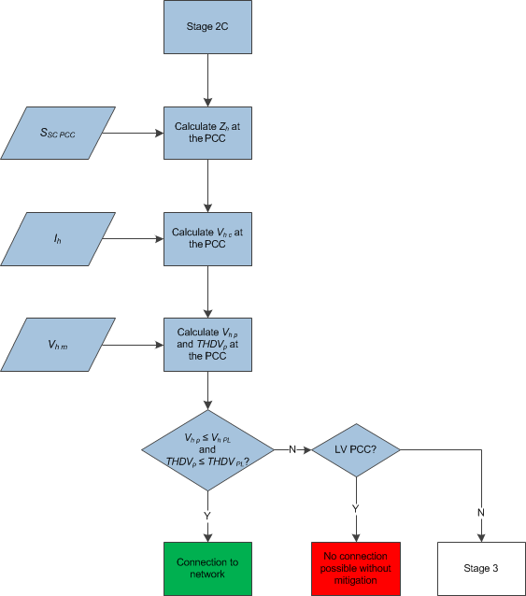
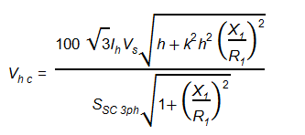



Stage 2C
$$\text{Z}\text{h}\text{ = }\sqrt{{\left(R_{1}\sqrt{h}\right)}^{2}+{{{k^{2}h}^{2}X}_{1}}^{2}}$$
Like existing G5/4-1 but now all harmonics checked
Distribution Code Public Consultation – DCRP/19/03/PC – Engineering Recommendation (EREC) G5 Issue 5 (2019) – Stakeholder Engagement Dissemination Event

Slide 72
Note
Note that the proposals omit a table of permitted harmonic currents like in Table 12 of G5/4-1.
NB In Stage 2C: “Note 1: To facilitate rapid assessment, it is permissible to assume that background harmonic distortion does not exceed 75% of the Planning Level subject to the agreement of the relevant Network Operator.”
Distribution Code Public Consultation – DCRP/19/03/PC – Engineering Recommendation (EREC) G5 Issue 5 (2019) – Stakeholder Engagement Dissemination Event

Slide 73
Summary
Proposed
Stages 1 & 2 – some major changes, some minor
Background - documented
Worked examples - extensive
Distribution Code Public Consultation – DCRP/19/03/PC – Engineering Recommendation (EREC) G5 Issue 5 (2019) – Stakeholder Engagement Dissemination Event

Slide 74
Any questions/comments?
Any questions/comments?
Distribution Code Public Consultation – DCRP/19/03/PC – Engineering Recommendation (EREC) G5 Issue 5 (2019) – Stakeholder Engagement Dissemination Event

Slide 75
EMC Directive
“Where apparatus is capable of taking different configurations, the electromagnetic compatibility assessment should confirm whether the apparatus meets the essential requirements in the configurations foreseeable by the manufacturer as representative of normal use in the intended applications. In such cases it should be sufficient to perform an assessment on the basis of the configuration most likely to cause maximum disturbance and the configuration most susceptible to disturbance.”
Distribution Code Public Consultation – DCRP/19/03/PC – Engineering Recommendation (EREC) G5 Issue 5 (2019) – Stakeholder Engagement Dissemination Event

Slide 76
EMC Directive
“It is not appropriate to carry out the conformity assessment of apparatus placed on the market for incorporation into a given fixed installation, and otherwise not made available on the market, in isolation from the fixed installation into which it is to be incorporated. Such apparatus should therefore be exempted from the conformity assessment procedures normally applicable to apparatus. However, such apparatus should not be permitted to compromise the conformity of the fixed installation into which it is incorporated. Should apparatus be incorporated into more than one identical fixed installation, identifying the electromagnetic compatibility characteristics of these installations should be sufficient to ensure exemption from the conformity assessment procedure.”
Distribution Code Public Consultation – DCRP/19/03/PC – Engineering Recommendation (EREC) G5 Issue 5 (2019) – Stakeholder Engagement Dissemination Event

Slide 77
Converter versus Rectifier
Type
Active Front-end Rectifier
Active Front-end Converter
Distribution Code Public Consultation – DCRP/19/03/PC – Engineering Recommendation (EREC) G5 Issue 5 (2019) – Stakeholder Engagement Dissemination Event

Slide 78
3-phase Rectifiers
Type
6-pulse | Diode Rectifier Thyristor Rectifier
Active Front-end (AFE) | Active Front-end Rectifier
Distribution Code Public Consultation – DCRP/19/03/PC – Engineering Recommendation (EREC) G5 Issue 5 (2019) – Stakeholder Engagement Dissemination Event

Slide 79
1 Phase Rectifier
Converter Type
1-phase Rectifier | Full-wave Diode Rectifier with Smoothing Capacitor
Distribution Code Public Consultation – DCRP/19/03/PC – Engineering Recommendation (EREC) G5 Issue 5 (2019) – Stakeholder Engagement Dissemination Event

Slide 80
Stage 1A Background
Distribution Code Public Consultation – DCRP/19/03/PC – Engineering Recommendation (EREC) G5 Issue 5 (2019) – Stakeholder Engagement Dissemination Event

Slide 81





Stage 1A Background
Z₁ = 0.8 x 0.6 x Z_{ref}
$$\text{Z}\text{h}\text{ = }\sqrt{{\left(R_{1}\sqrt{h}\right)}^{2}+{{{k^{2}h}^{2}X}_{1}}^{2}}$$
$$V_{hc}\%=\frac{{100Z}_{h}I_{h}}{230}$$
$$N_{h}=\frac{G_{hLVM}^{α}}{V_{hc\%}^{α}}$$
Connection Phases | Reference Source Impedance
 | <100A Service Capacity | ≥100A Service Capacity
1 | 0.4 + j0.25Ω | 0.25 + j0.25Ω
3 | 0.24 + j0.15Ω | 0.15 + j0.15Ω
$$N_{h}=\frac{{G_{hLVM}}^{∝}}{{\left(\frac{100}{230}I_{h}\sqrt{{\left(R_{1}\sqrt{h}\right)}^{2}+{{k^{2}h^{2}X}_{1}}^{2}}\right)}^{∝}}$$
Distribution Code Public Consultation – DCRP/19/03/PC – Engineering Recommendation (EREC) G5 Issue 5 (2019) – Stakeholder Engagement Dissemination Event

Slide 82
Analysis
Equipment Type | Maximum Number of Items, N_{h} | Limiting Harmonic, h_{lim}
600W rectifier (2mF cap) | 13 | 3
Heat Pump (Mean) | 14 | 3
Electric Vehicle (3.6kVA) | 19 | 33
Typical emissions
  Basic 600W rectifier (no active PFC)
  Active PFC:
    Mean heat pump
    3.6kVA EV examples
Assumed Z_{PCC}<Z_{ref} & allow for distributed customers
  Z_{PCC}= 0.8 x 0.6 Z_{ref}
Conclusion: allow unconditional connection
Distribution Code Public Consultation – DCRP/19/03/PC – Engineering Recommendation (EREC) G5 Issue 5 (2019) – Stakeholder Engagement Dissemination Event

Slide 83
DCRP/19/03/PC – Engineering Recommendation (EREC) G5 Issue 5 (2019) – Distribution Code Public Consultation – Resonant Plant at LV up to 11 kV
Name Forooz Ghassemi
Company National Grid
Date 1st April 2019

Slide 84
Resonant plant connection
A resonant plant assessment is applicable to connection of any resonant plant and equipment
Resonant plant can be power factor correction capacitors, long cables or any other plant or equipment that can be considered predominately capacitive at any range of harmonic frequencies
They can potentially magnify a background harmonic level beyond the planning level
Simple but conservative assessment
Magnification factors of 1.33 for harmonics up to and including 15th order and 2 above 15th harmonic are allowed
If the aggregated voltage resulted from resonant plant magnified background and the emission from the plant is below 75% of the planning level then the connection is allowed
If a connection fails resonant plant assessment, it is assessed under Stage 3 which is based on more detail
Distribution Code Public Consultation – DCRP/19/03/PC – Engineering Recommendation (EREC) G5 Issue 5 (2019) – Stakeholder Engagement Dissemination Event

Slide 85
DCRP/19/03/PC – Engineering Recommendation (EREC) G5 Issue 5 (2019) – Distribution Code Public Consultation – Stage 3
Name Forooz Ghassemi
Company National Grid
Date 1st April 2019

Slide 86
Stage 3 assessment
It applies to connections:
  At 33 kV and above
  Those which failed Stage 2C
  Those which failed resonant plant assessment
The output of the assessment is sets of limits enforced at the PCC and supply system harmonic impedance of the PCC
This is known as harmonic specification, that the NO responsible for the connection issues to the new user
Distribution Code Public Consultation – DCRP/19/03/PC – Engineering Recommendation (EREC) G5 Issue 5 (2019) – Stakeholder Engagement Dissemination Event

Slide 87
Stage 3 assessment features
Similar to G5/4-1, in order to ensure compliance, all nodes in the network that are likely to be affected by the new connection, these are known as remote nodes, are included in the assessment together with the PCC
The limits are based on apportionment of the harmonic headroom; this is different to G5/4-1 that is based on first come-first served
at least two sets of limits should be included in the harmonic specification:
  Limits for incremental impact due to emission, this is also defined in G5/4-1
  Limits for total effect that includes the impact on amplification of background, this is not explicitly defined in G5/4-1
  The existing background measurement is part of the harmonic specification
Distribution Code Public Consultation – DCRP/19/03/PC – Engineering Recommendation (EREC) G5 Issue 5 (2019) – Stakeholder Engagement Dissemination Event

Slide 88
Why headroom apportionment
In first come first served method:
  The first in the queue who might be a small, say 10 MVA connection gets all of the headroom
  The next in the queue who may be a 50 MVA connection and connects immediately after the first will get nothing
In calculating the limits, no emission or network data is required from the new user
This is different to G5/4-1, whose assessment is based on emission and passive element data
Distribution Code Public Consultation – DCRP/19/03/PC – Engineering Recommendation (EREC) G5 Issue 5 (2019) – Stakeholder Engagement Dissemination Event

Slide 89
Transfer coefficient
Transfer coefficients are useful network parameters that can be used to assess the effect of one node on other nodes in the network
The transfer coefficient between two nodes in a network is defined as the ratio of the voltage produced at a node due to the current injected at another node
It is calculated by:
At 50 Hz, transfer coefficient is usually from slightly above unity to around zero
Due to resonance conditions at harmonic frequencies, harmonic transfer coefficients may be much higher than unity, controlled only by damping in the network
Thus, a harmonic source may cause higher distortion at remote nodes than the PCC
Also, the background level at remote nodes may be higher than PCC, causing PL to be exceeded
Distribution Code Public Consultation – DCRP/19/03/PC – Engineering Recommendation (EREC) G5 Issue 5 (2019) – Stakeholder Engagement Dissemination Event

Slide 90
Harmonic headroom
Harmonic headroom at each node, is the difference between the planning level and measured background; the difference may not be linear
Harmonic headroom is calculated for the PCC and the remote nodes
Remote node harmonic headroom are transferred to the PCC through harmonic transfer coefficients between the PCC and remote nodes
H_{h n PCC} is the headroom at Node n, transferred to the PCC
It is a measure of how much distortion at a given harmonic can be generated at the PCC without remote node harmonic level exceeding the planning level
Distribution Code Public Consultation – DCRP/19/03/PC – Engineering Recommendation (EREC) G5 Issue 5 (2019) – Stakeholder Engagement Dissemination Event

Slide 91
The components of limits
At least two sets of limits plus the background measurement should be included in the harmonic specification
  the limits for incremental
  total harmonic levels
Incremental effect is defined as changes in the all remote nodes and the PCC due to harmonic emission from the new user only
The total effect is defined as the harmonic level at the PCC after a new user has been connected
The limit change is the total change in the harmonic level that is allowed at the PCC due to the new user connection
Other components of limits, such as limits for magnification of background, can be derived from the harmonic specification
Distribution Code Public Consultation – DCRP/19/03/PC – Engineering Recommendation (EREC) G5 Issue 5 (2019) – Stakeholder Engagement Dissemination Event

Slide 92
The limits
For setting the limits only the MVA of the new connection is required
The incremental limit is determined by apportioning the smallest of the transferred headrooms from remote nodes and headroom at the PCC:
The total changed that the new connection can produce at the PCC is calculated by apportioning the headroom at the PCC:
this includes the limit for incremental effect
The total limit is determined by aggregating the background and the total change allowed:
The total limit is a directly measurable quantity at the PCC
Distribution Code Public Consultation – DCRP/19/03/PC – Engineering Recommendation (EREC) G5 Issue 5 (2019) – Stakeholder Engagement Dissemination Event

Slide 93
Apportionment curve
Multiplier M is used to apportion the headroom(s)
Considering number of connections and typical connection size at each voltage level, for distribution voltage levels M is a constant of 0.5 for voltages of 132 kV and below
This means the limits for each connection is 50% of the headroom
For voltages above 132 kV, M is determined according to k_{M}
this means the apportionment is proportional to the MVA size of the connection
β value for voltages above 132 kV
Nominal phase–phase voltage (V) kV | β value
132 < V < 275 | 1000
275 | 1500
400 | 2000
Distribution Code Public Consultation – DCRP/19/03/PC – Engineering Recommendation (EREC) G5 Issue 5 (2019) – Stakeholder Engagement Dissemination Event

Slide 94
Setting β
The size (MVA) of all connections to the transmission system in the last two decades until 2022 were analysed
β for different voltage levels was selected such that approximately 75% of all connections will have a k_{M} of 0.25 or more
β was so selected that k_{M} of 1.0 corresponds to the highest non-linear connection at 400 kV
There is not many non-linear connection at 275 kV, thus k_{M} of 1.0 corresponds approximately to the 99-percentile of conventional connections at 275 kV
Distribution Code Public Consultation – DCRP/19/03/PC – Engineering Recommendation (EREC) G5 Issue 5 (2019) – Stakeholder Engagement Dissemination Event

Slide 95

Limits for modification of background
Limit for modification of background is now explicitly defined in G5
It is included in the limit for change and is given by:
${ \text{V}}_{\text{h} \text{Limit} \text{Resonant}}\text{ = }\sqrt[\text{α}]{{\left({\text{V}}_{\text{h} \text{Limit} \text{Change}}\right)}^{\text{α}}\text{ – }{\left({\text{V}}_{\text{h} \text{Inc}}\right)}^{\text{α}}}\text{ = }\sqrt[\text{α}]{{\left({\text{MH}}_{\text{h} \text{PCC}}\right)}^{\text{α}}\text{ – }{\left({\text{V}}_{\text{h} \text{Inc}}\right)}^{\text{α}}}$
${\text{V}}_{\text{h} \text{Inc}}$ is the actual incremental voltage that is produced by the new connection at PCC
In practice, for some harmonics, V_{h Inc} may be zero, e.g. no injection from user’s equipment, and must always be equal to or less than V_{h Limit Inc}
The difference between V_{h Limit Inc} and V_{h Inc} may be used to accommodate for the effects of modification of the background harmonic level
The allowance for modification of the background harmonic level must not be used to accommodate for the incremental changes
Note:
in the diagram opposite it has been assumed that for the harmonic order considered, all of the incremental limit is used by the new equipment, i.e. V_{h Inc} =V_{h Limit Inc}
This is not usually the case for all harmonics
Distribution Code Public Consultation – DCRP/19/03/PC – Engineering Recommendation (EREC) G5 Issue 5 (2019) – Stakeholder Engagement Dissemination Event

Slide 96
Harmonic specification
As a minimum requirement, the incremental and total limits and background measurement will be specified in the harmonic specification
Limit change may be explicitly included in the specification
Harmonic impedance as impedance loci or tabular form is also part of the harmonic specification
Example limits forming part of a harmonic specification
Harmonic order (h) | Background harmonic level ¹⁾ % h = 1 | Incremental harmonic voltage limit ²⁾ % h = 1 | Total harmonic voltage limit % h = 1
2 | TBA | TBA | TBA
3 | TBA | TBA | TBA
4 | TBA | TBA | TBA
... | ... | ... | ...
... | ... | ... | ...
NOTE: All values apply at the PCC.
¹⁾ Prior to connection of the new user’s plant and equipment. ²⁾ Due to harmonic emission of the new user’s plant and equipment.
Distribution Code Public Consultation – DCRP/19/03/PC – Engineering Recommendation (EREC) G5 Issue 5 (2019) – Stakeholder Engagement Dissemination Event

Slide 97

Compliance criteria
Compliance with the Stage 3 harmonic specification is achieved if the new user satisfies the following two requirements:
  Compliance with the incremental harmonic voltage limits (V_{h Limit Inc})
  Compliance with the total harmonic voltage limits (V_{h Limit Total})
The total harmonic voltage at the PCC shall be less than or equal to the total harmonic voltage limit (V_{h Limit Total})
${\text{V}}_{\text{h} \text{Total} }\text{≤ }{\text{V}}_{\text{h} \text{Limit} \text{Total}}$
${\text{V}}_{\text{h} \text{Total} }$is the calculated total effect after the user is connected and is given by:
${ \text{V}}_{\text{h} \text{Total}}\text{ = }\sqrt[\text{α}]{{\left({\text{V}}_{\text{h} \text{Inc}}\right)}^{\text{α}}+{\left(\frac{\left|{\text{Z}}_{\text{h} \text{PCC} \text{Post}}\right|}{\left|{\text{Z}}_{\text{h} \text{PCC} \text{Pre}}\right|}{\text{V}}_{\text{h} \text{bg} \text{PCC}}\right)}^{\text{α}}}$
Data from the new user’s installation is required to enable calculation of the post-connection self-impedance at the PCC
Distribution Code Public Consultation – DCRP/19/03/PC – Engineering Recommendation (EREC) G5 Issue 5 (2019) – Stakeholder Engagement Dissemination Event

Slide 98
Compliance report
The user submits a post design compliance report in the time scale agreed with NO facilitating the connection, it should contain the followings:
  Demonstration of compliance with the harmonic specification, which contains, as a minimum, compliance with the incremental harmonic voltage limit and total harmonic voltage limit at the PCC
  V_{h Inc}, taking into account all operating conditions and configurations of the new installation, and the corresponding V_{h Limit Resonant}
  V_{h Total}, considering all operating conditions and configurations of the new installation
  Equivalent Thévenin harmonic impedance of the proposed installation as seen from the PCC, with different values, as applicable, to cover the various operating conditions and configurations of the installation
  Equivalent Thévenin voltage or Norton current source harmonic emission model at the PCC, with different values, as applicable, to cover the various operating conditions and configurations of the installation in relation to the corresponding abovementioned equivalent Thévenin harmonic impedance
Distribution Code Public Consultation – DCRP/19/03/PC – Engineering Recommendation (EREC) G5 Issue 5 (2019) – Stakeholder Engagement Dissemination Event

Slide 99
Compliance by measurement
Compliance with the specified harmonic limits may be verified by harmonic measurements made by the host NO before, during and after commissioning is complete
The decision as to what measurements are required should rest with the NOs affected
It is useful that at least four weeks of harmonic measurement is carried out before the commissioning begins, allowing the background harmonic level of the supply system at the PCC to be established, immediately before the new user is connected
Harmonic levels should be monitored during the commissioning stages
Distribution Code Public Consultation – DCRP/19/03/PC – Engineering Recommendation (EREC) G5 Issue 5 (2019) – Stakeholder Engagement Dissemination Event

Slide 100
Compliance by measurement
The continuous monitoring during commissioning, and afterwards, will show the changes that the new user causes at the PCC, for the supply system configuration at the time of commissioning
Total effect of the new connection can be measured
Non-compliance condition may arise due to one or more major issues below:
  Fault in design
  Impedance data provided by NO did not include the most recent changes in the network, prevailed during measurement
  The actual aggregated distortions caused by different sources did not follow the IEC aggregation rule
Distribution Code Public Consultation – DCRP/19/03/PC – Engineering Recommendation (EREC) G5 Issue 5 (2019) – Stakeholder Engagement Dissemination Event

Slide 101
Connection queue
In the cases where multiple connections are expected to connect within similar timescales, the order of allocating limits and issuing the harmonic specification is determined by the date at which the connection offer is signed by the new user
After a new user’s installation is commissioned and fully operational, the new user is considered to be part of the background harmonic level and new measurements shall be taken for the next connection application
In cases where the next new user should be issued the harmonic specification before the previous new user in the queue being commissioned then the harmonic voltage limits issued to the first new user is used to estimate the background harmonic level for the next new user
Distribution Code Public Consultation – DCRP/19/03/PC – Engineering Recommendation (EREC) G5 Issue 5 (2019) – Stakeholder Engagement Dissemination Event

Slide 102
Need for guidance on concurrent connections
For concurrent connections,
  limits should be issued to the next user in the queue without the first being part of the background, i.e. not yet built or fully operational
G5/4-1 did not give any guidance for concurrent connections
Due to increase in non-linear connections, the need for guidance for concurrent connections was one of the main items for reviewing G5/4-1
Distribution Code Public Consultation – DCRP/19/03/PC – Engineering Recommendation (EREC) G5 Issue 5 (2019) – Stakeholder Engagement Dissemination Event

Slide 103
Guidance for concurrent connections
The G5/5 apportionment approach enables NOs to issue limits to two or several concurrent connections by estimating the impact of the limits issued to the previous connection on the background for the next connection
The impact on the impedance profile at the PCC cannot be standardised with good degree of confidence
NOs and users should reach agreement on the case by case basis
If design data for the first user is not yet available to be included in the harmonic model for the next user then agreement between the two parties must be made for the latest model to be used
Distribution Code Public Consultation – DCRP/19/03/PC – Engineering Recommendation (EREC) G5 Issue 5 (2019) – Stakeholder Engagement Dissemination Event

Slide 104

Concurrent connections at the same node
The limits issued to the first user is considered to modify the background for the next user
It is assumed the background at the PCC raises to the total limit for the first user, i.e. ${\text{V}}_{\text{h} \text{bg} \text{PCC}\text{ 2}}\text{ = }{\text{V}}_{\text{h} \text{Limit} \text{Total}\text{ 1}}$
A new headroom at the PCC is estimated using the above background
All the transferred remote nodes’ headrooms are modified by the incremental limit for the first user
Then the apportionment on the modified headrooms are carried out to calculate the new incremental and total limits
Distribution Code Public Consultation – DCRP/19/03/PC – Engineering Recommendation (EREC) G5 Issue 5 (2019) – Stakeholder Engagement Dissemination Event

Slide 105
Concurrent connections at different nodes
Two connections in the queue may be connecting to nodes electrically close within a relatively short time of each other
The background harmonic level for the second connection must be estimated to account for the previous connection
The background harmonic level at all nodes within the study shall be modified by the incremental harmonic voltage limit (V_{h Limit Inc 1}) issued to the first new user
It is assumed that the background harmonic level at the first PCC will rise to the total harmonic voltage limit that was assigned to the first new user
After calculating the headroom at the first PCC, then it is transferred to the second PCC by using the transfer coefficient from second PCC to the first PCC
Note: The transfer coefficient from the first PCC to the second is not the same as transfer coefficient from the second to first, because the self impedance at these two nodes may be different
Distribution Code Public Consultation – DCRP/19/03/PC – Engineering Recommendation (EREC) G5 Issue 5 (2019) – Stakeholder Engagement Dissemination Event

Slide 106
Illustration of adjusted backgrounds
All nodes background measurements are adjusted by the incremental limit for NC1 through the transfer coefficient from PCC1 to other nodes, e.g. Node B
It is assumed harmonic levels at PCC1 rise to the total limit
This is used to calculated the headroom at PCC1 and then transferred to PCC2
Measured background for PCC2 when setting limits for PCC1
Setting limits for PCC1
NC1: New Connection 1
NC2: New Connection 2
Setting limits for PCC2
Note the adjusted background modified by the transferred incremental limit for NC1 to PCC2
106
Distribution Code Public Consultation – DCRP/19/03/PC – Engineering Recommendation (EREC) G5 Issue 5 (2019) – Stakeholder Engagement Dissemination Event

Slide 107
Distribution Code Public Consultation – DCRP/19/03/PC – Engineering Recommendation (EREC) G5 Issue 5 (2019) – Stakeholder Engagement Dissemination Event
Closing
Second Stakeholder Engagement – Glasgow 10th April 09:30-16:00
Consultation Next Steps
  A comprehensive consultation pack with further details can be downloaded from the Distribution Code Website using the following link- http://www.dcode.org.uk/consultations/open-consultations/ and opening consultation tab DCRP/19/03/PC.
  Responses to this consultation should be sent to the Distribution Code Administrator at dcode@energynetworks.org by 17:00 on 19 April 2019 on the pro-forma provided in the pack. Responses received after this date may not be considered.

